Slide 1
Mystery Shop Update

Slide 2
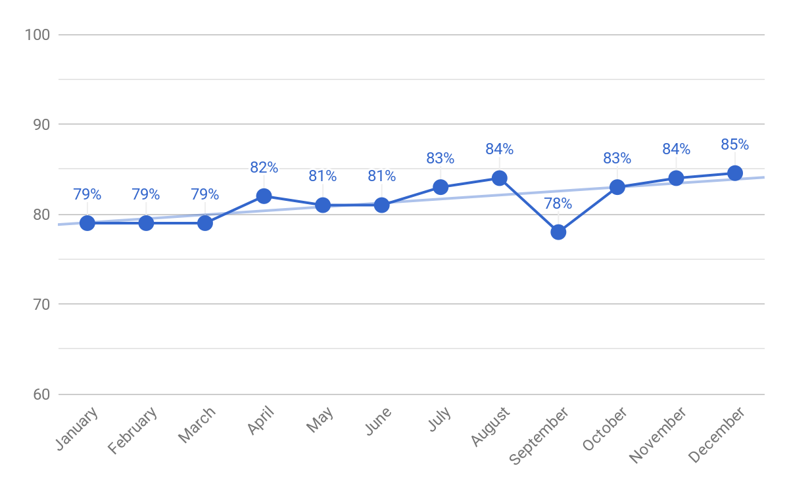
STRIPES – MYSTERY SHOP SCORING
Notes:
NEW

Slide 3
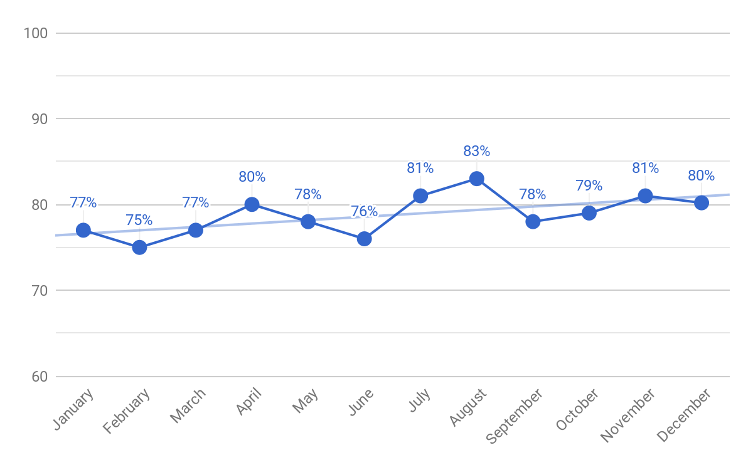
REGION 100 – MYSTERY SHOP SCORING
Notes:
NEW

Slide 4
REGION 100 – BOTTOM STORES TREND
Area Manager | January | February | March | April | May | June | July | August | September | October | November | December
119 Tony Goodnature | 75% | 73% | 84% | 82% | 78% | 74% | 79% | 81% | 72% | 73% | 79% | 76%
110 Liliana Rutledge | 70% | 65% | 73% | 78% | 76% | 66% | 79% | 77% | 76% | 74% | 82% | 74%
118 JoAnn Sanchez | 78% | 65% | 76% | 77% | 70% | 70% | 81% | 74% | 76% | 75% | 78% | 74%
107 Jesse Quezada | 74% | 70% | 72% | 77% | 77% | 63% | 79% | 78% | 81% | 72% | 74% | 71%
108 Roy Cooper | 68% | 70% | 69% | 78% | 76% | 69% | 76% | 77% | 70% | 79% | 76% | 71%
Notes:
NEW

Slide 5
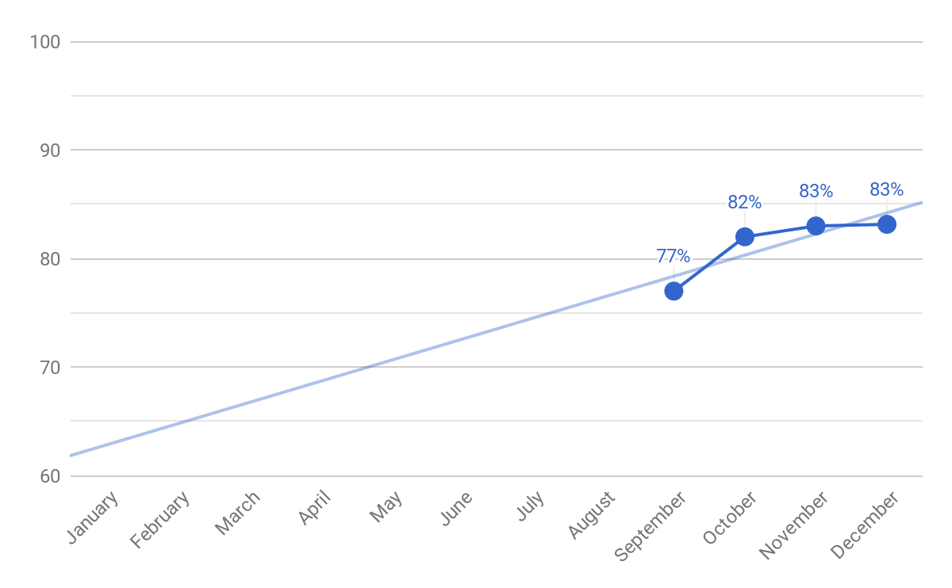
REGION 1100– MYSTERY SHOP SCORING

Slide 6
REGION 1100 – BOTTOM STORES TREND
Area Manager | January | February | March | April | May | June | July | August | September | October | November | December
1109 Jorge Gonzalez | 80% | 74% | 75% | 76% | 76% | 76% | 85% | 78% | 78% | 83% | 79% | 81%
1108 Angel Guzman | 75% | 74% | 68% | 71% | 73% | 75% | 79% | 65% | 69% | 75% | 78% | 80%
1102 Alecia Jenkins | 77% | 70% | 70% | 86% | 83% | 81% | 79% | 84% | 82% | 87% | 87% | 79%
1107 Corey Tobias | 85% | 83% | 76% | 78% | 70% | 79% | 77% | 78% | 68% | 76% | 79% | 78%
1101 Tim Toepfer | 80% | 81% | 66% | 94% | 81% | 84% | 77% | 75% | 69% | 88% | 86% | 73%

Slide 7
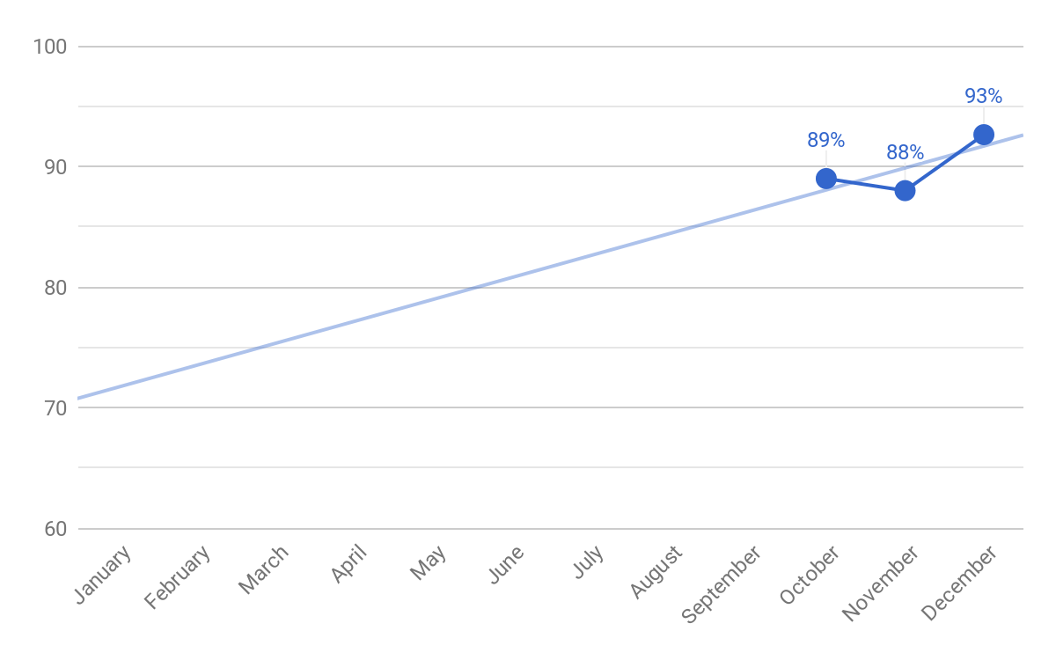
REGION 1200 – MYSTERY SHOP SCORING

Slide 8
REGION 1200 – BOTTOM STORES TREND
Area Manager | January | February | March | April | May | June | July | August | September | October | November | December
1208 Perla Beltran | 79% | 91% | 92% | 89% | 88% | 89% | 83% | 95% | -- | 85% | 89% | 92%
1205 Emma Flores | 82% | 88% | 85% | 90% | 75% | 87% | 85% | 88% | -- | 87% | 94% | 91%
1201 Efrain Trevino | 85% | 83% | 74% | 82% | 86% | 77% | 83% | 82% | -- | 85% | 77% | 91%
1206 Lupita Reyes | 82% | 89% | 83% | 92% | 84% | 89% | 87% | 89% | -- | 86% | 89% | 88%
1207 Tino Lozano | 82% | 85% | 81% | 79% | 90% | 83% | 85% | 81% | -- | 89% | 83% | 87%

Slide 9
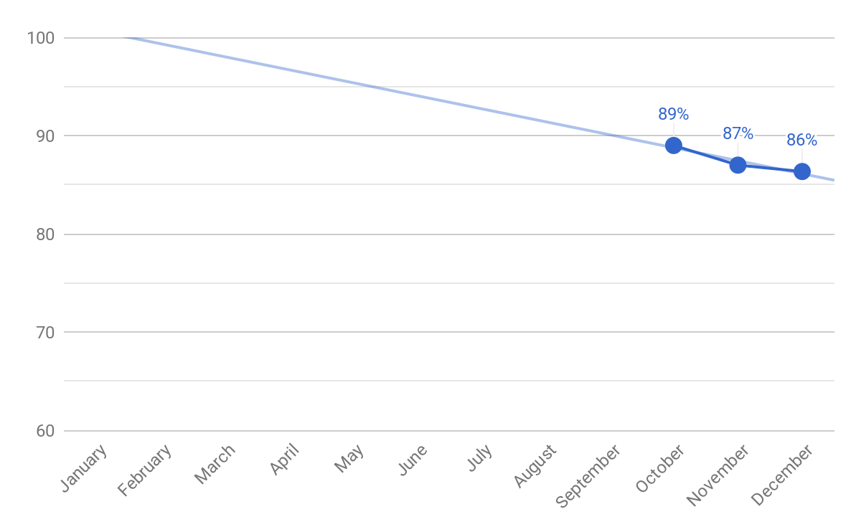
REGION 1300 – MYSTERY SHOP SCORING

Slide 10
REGION 1300 – BOTTOM STORES TREND
Area Manager | January | February | March | April | May | June | July | August | September | October | November | December
1309 Jesse Chavez | 74% | 80% | 75% | 79% | 75% | 78% | 86% | 79% | -- | 80% | 82% | 85%
1305 Yolanda Flores | 80% | 78% | 85% | 82% | 78% | 81% | 91% | 82% | -- | 86% | 90% | 85%
1306 Yadira Perez | 71% | 82% | 77% | 88% | 82% | 82% | 90% | 83% | -- | 89% | 87% | 83%
1310 Ismael Flores | 80% | 85% | 87% | 78% | 87% | 93% | 91% | 92% | -- | 94% | 94% | 82%
1308 Manuel Martinez | 80% | 87% | 78% | 84% | 76% | 77% | 88% | 81% | -- | 86% | 88% | 82%

Slide 11
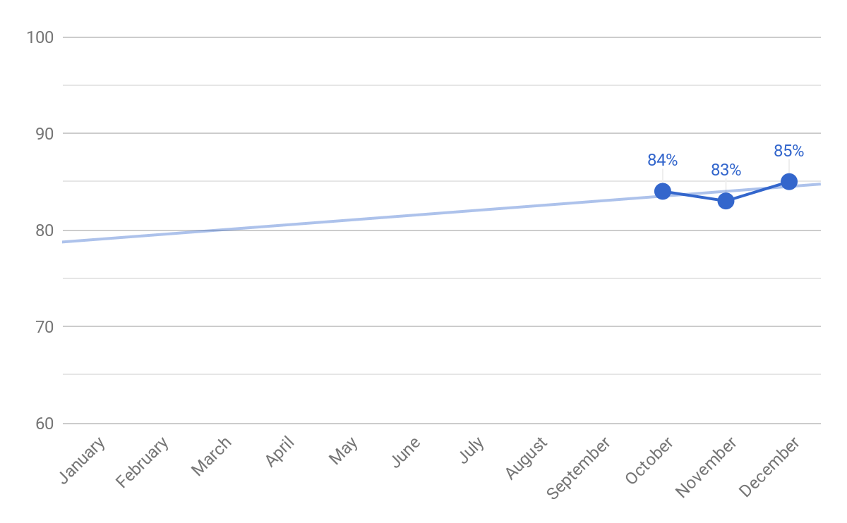
REGION 1400 – MYSTERY SHOP SCORING

Slide 12
REGION 1400 – BOTTOM STORES TREND
Area Manager | January | February | March | April | May | June | July | August | September | October | November | December
1402 Area Manager 1402 | 79% | 79% | 79% | 73% | 82% | 80% | 81% | 84% | -- | 78% | 79% | 83%
1405 Jimmy Seidenberg | 78% | 74% | 79% | 79% | 82% | 85% | 81% | 89% | -- | 94% | 80% | 83%
1408 Kim Garlington | 85% | 82% | 82% | 81% | 81% | 73% | 89% | 86% | -- | 74% | 86% | 81%
1401 Eddie Alarcon | 82% | 76% | 73% | 73% | 85% | 77% | 84% | 78% | -- | 84% | 78% | 80%
1411 Hector Deleon | 77% | 76% | 71% | 81% | 77% | 76% | 79% | 77% | -- | 84% | 78% | 77%

Slide 13
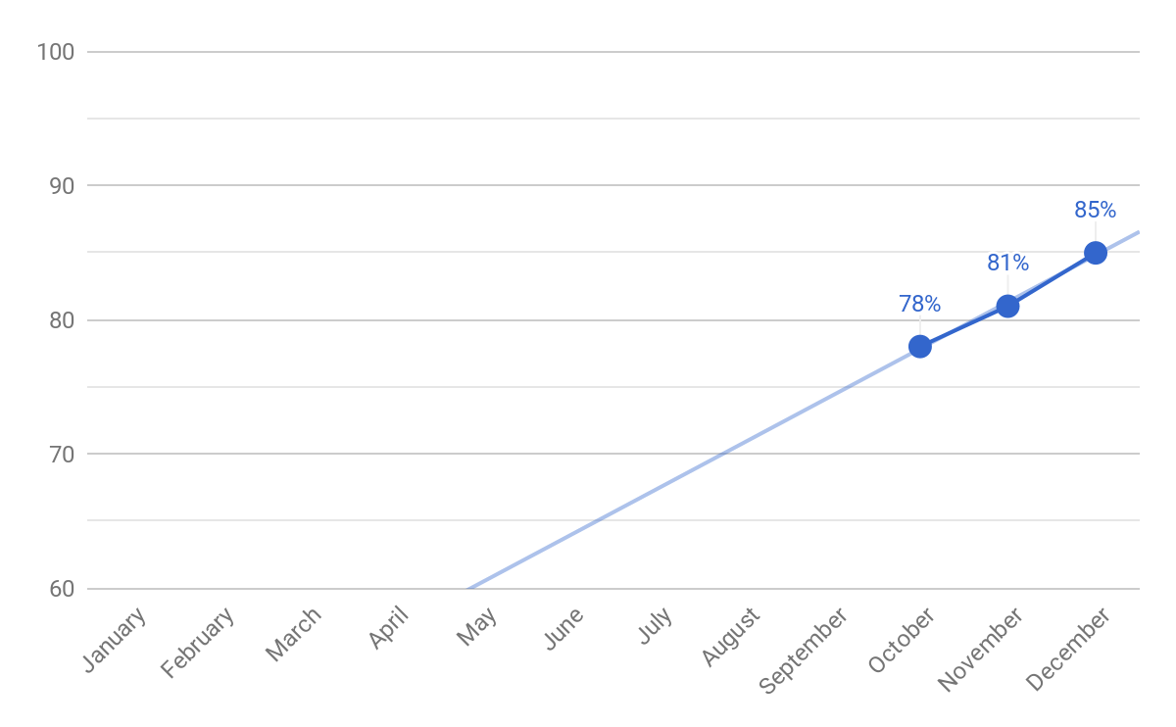
REGION 1500 – MYSTERY SHOP SCORING

Slide 14
REGION 1500 – BOTTOM STORES TREND
Area Manager | January | February | March | April | May | June | July | August | September | October | November | December
1508 Patrick Landry | 73% | 83% | 68% | 81% | 83% | 82% | 74% | 79% | -- | 75% | 77% | 84%
1504 Mike Bahlawan | 85% | 78% | 83% | 78% | 90% | 92% | 82% | 69% | -- | 75% | 82% | 84%
1502 Gilbert Morales | 74% | 80% | 84% | 72% | 80% | 72% | 76% | 83% | -- | 75% | 81% | 81%
1503 Ricardo Amador | 75% | 78% | 83% | 82% | 76% | 66% | 75% | 85% | -- | 73% | 73% | 80%
1510 Shawn McCoy | 66% | 76% | 68% | 81% | 78% | 81% | 72% | 80% | -- | 77% | 71% | 76%

Slide 15
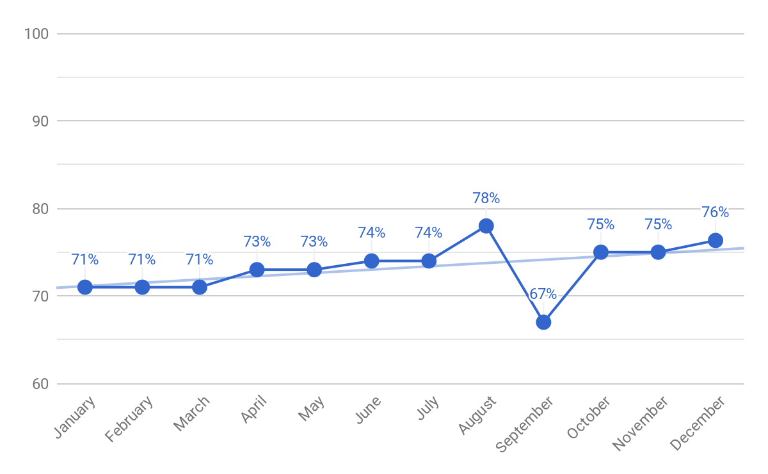
FAST & FRIENDLY FILTER – MYSTERY SHOP SCORING

Slide 16
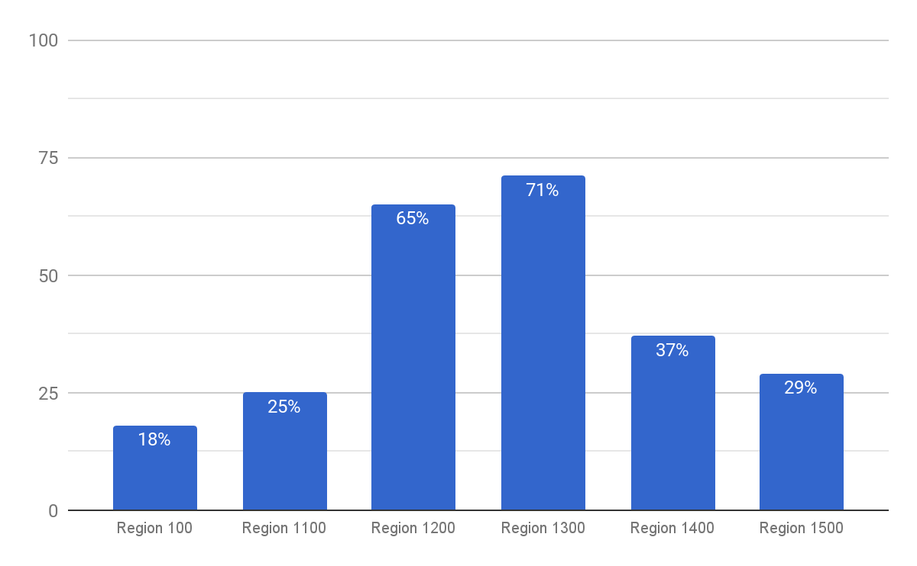
FAST & FRIENDLY FILTER – DECEMBER MYSTERY SHOP SCORES

Slide 17
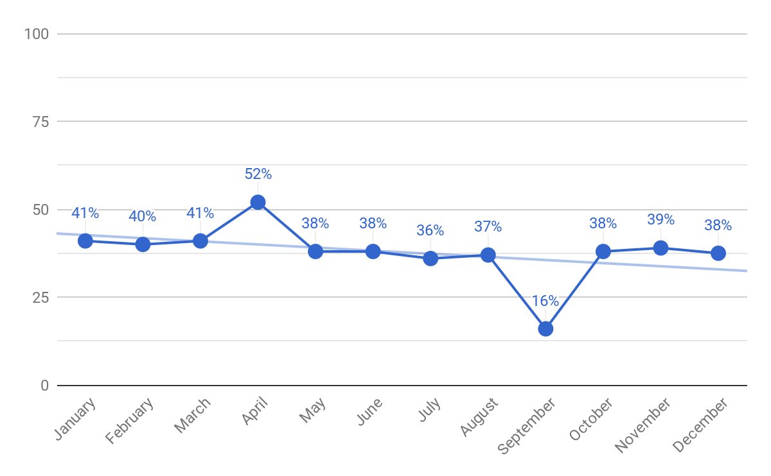
MYSTERY SHOP TOP OPPORTUNITY – TREND
(Fast & Friendly) Did the sales associate offer the guest an upsell item and/or suggest a complimentary item with their purchase? (3pts)

Slide 18
MYSTERY SHOP TOP OPPORTUNITY – REGIONS
(Fast & Friendly) Did the sales associate offer the guest an upsell item and/or suggest a complimentary item with their purchase? (3pts)

Slide 19
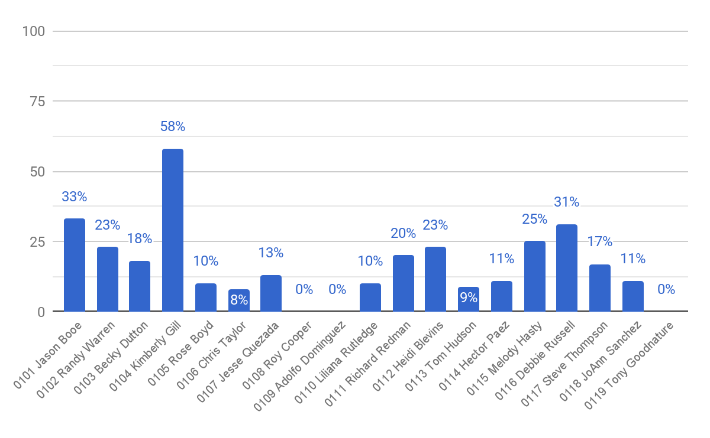
MYSTERY SHOP TOP OPPORTUNITY – REGION 100
(Fast & Friendly) Did the sales associate offer the guest an upsell item and/or suggest a complimentary item with their purchase? (3pts)

Slide 20
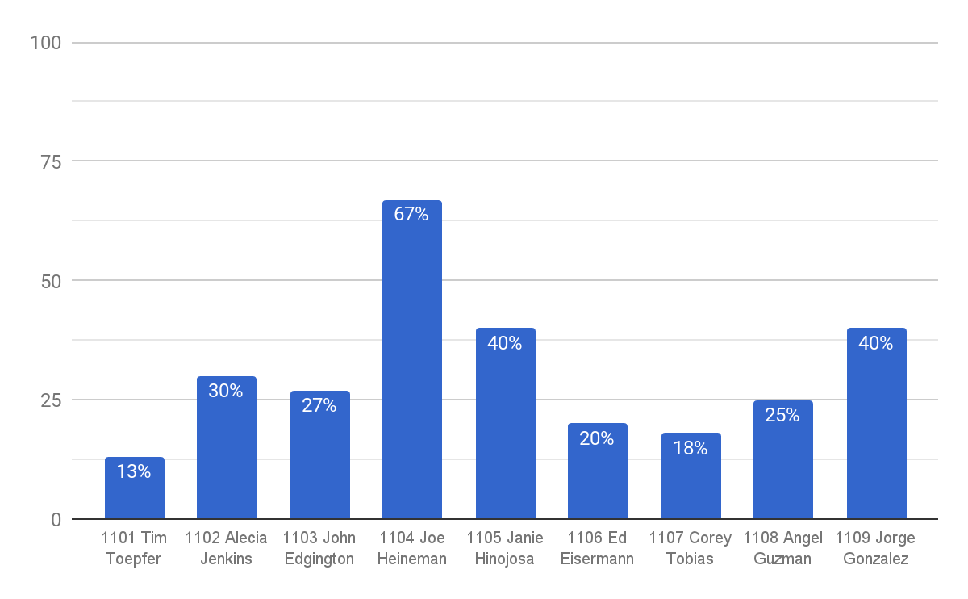
MYSTERY SHOP TOP OPPORTUNITY – REGION 1100
(Fast & Friendly) Did the sales associate offer the guest an upsell item and/or suggest a complimentary item with their purchase? (3pts)

Slide 21
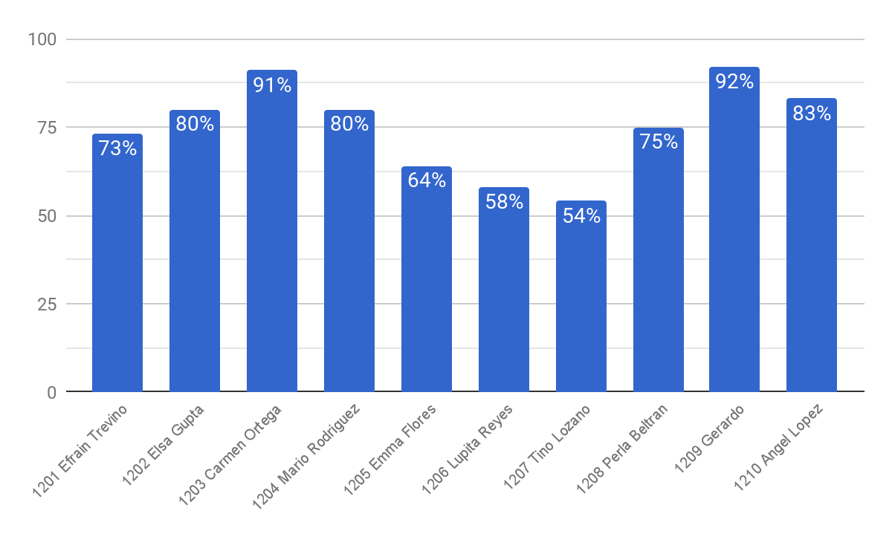
MYSTERY SHOP TOP OPPORTUNITY – REGION 1200
(Fast & Friendly) Did the sales associate offer the guest an upsell item and/or suggest a complimentary item with their purchase? (3pts)

Slide 22
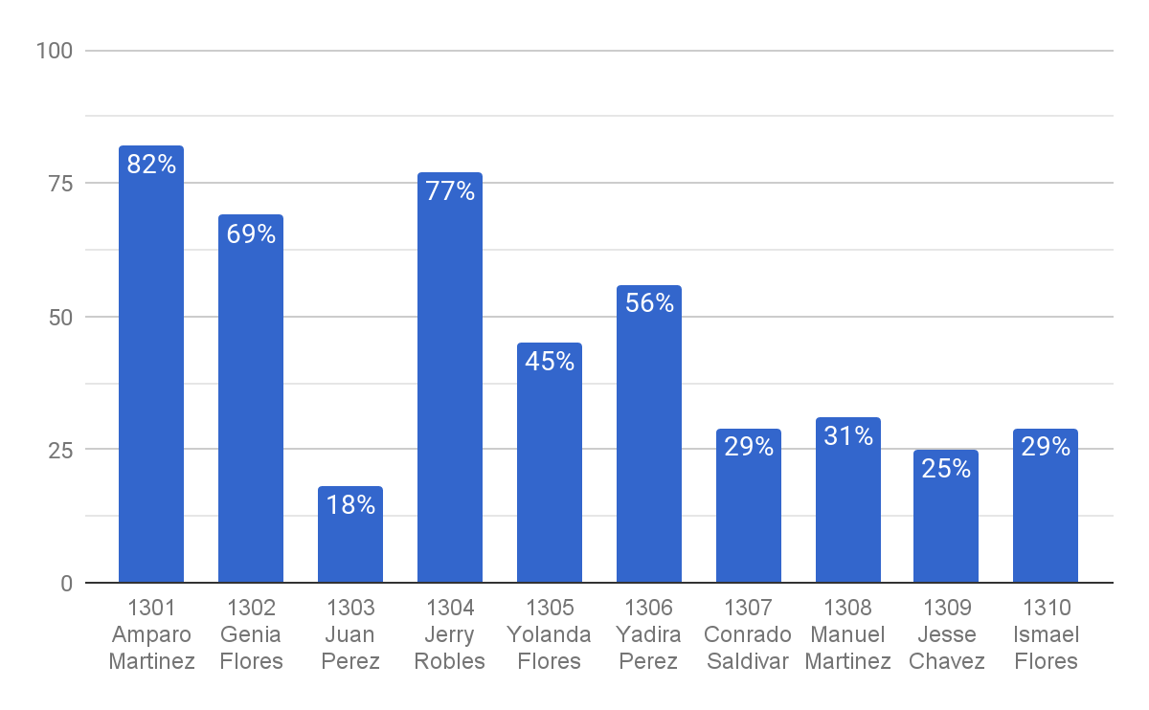
MYSTERY SHOP TOP OPPORTUNITY – REGION 1300
(Fast & Friendly) Did the sales associate offer the guest an upsell item and/or suggest a complimentary item with their purchase? (3pts)

Slide 23
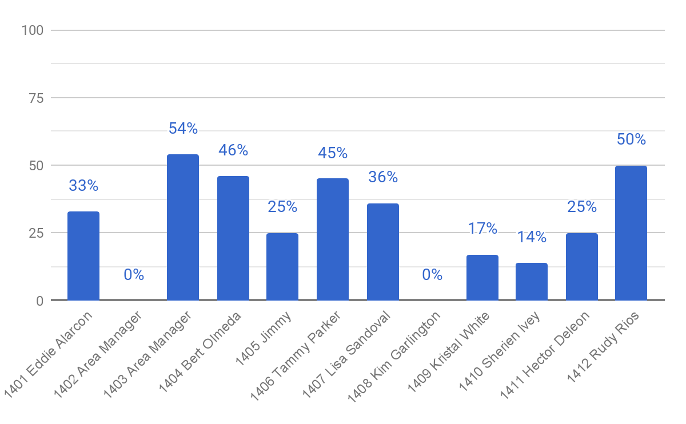
MYSTERY SHOP TOP OPPORTUNITY – REGION 1400
(Fast & Friendly) Did the sales associate offer the guest an upsell item and/or suggest a complimentary item with their purchase? (3pts)

Slide 24
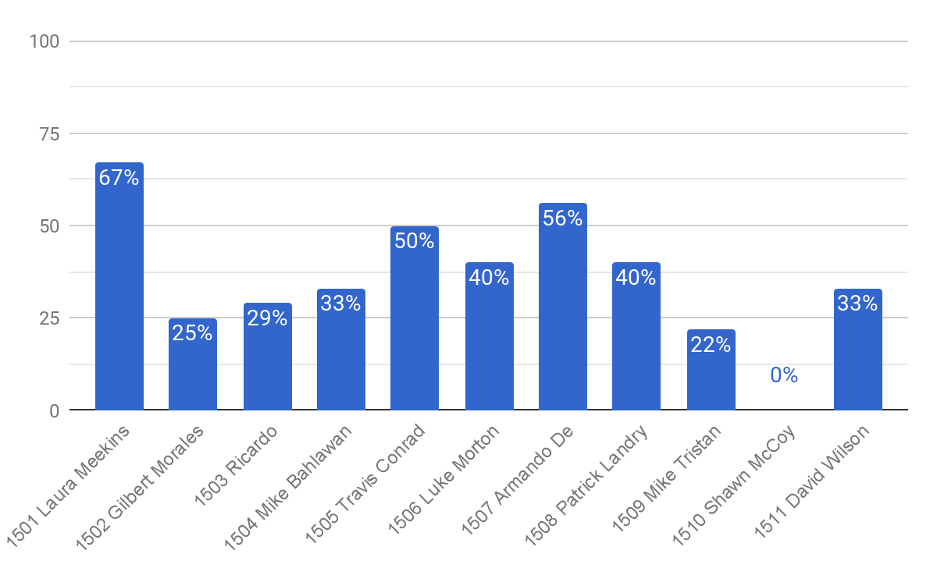
MYSTERY SHOP TOP OPPORTUNITY – REGION 1500
(Fast & Friendly) Did the sales associate offer the guest an upsell item and/or suggest a complimentary item with their purchase? (3pts)

Slide 25
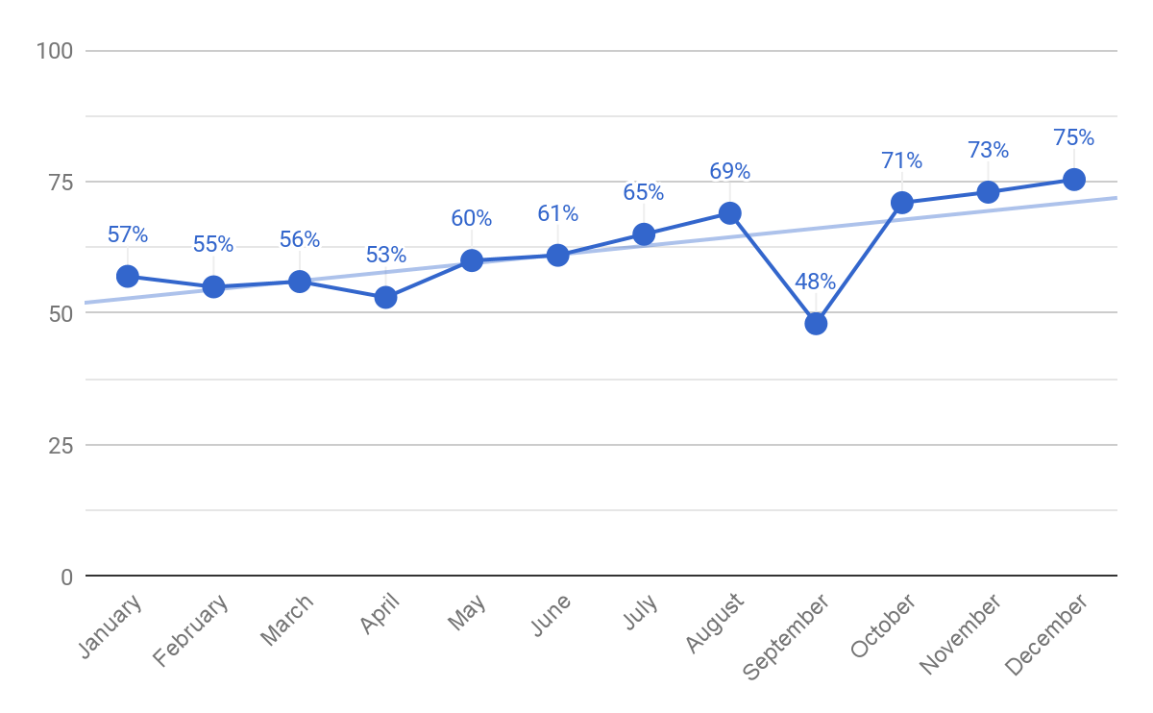
MYSTERY SHOP TOP OPPORTUNITY – TREND
(Fast & Friendly) Were all refrigerated beverage (soda, beer, juice, milk, vault) doors well stocked? (4pts)

Slide 26
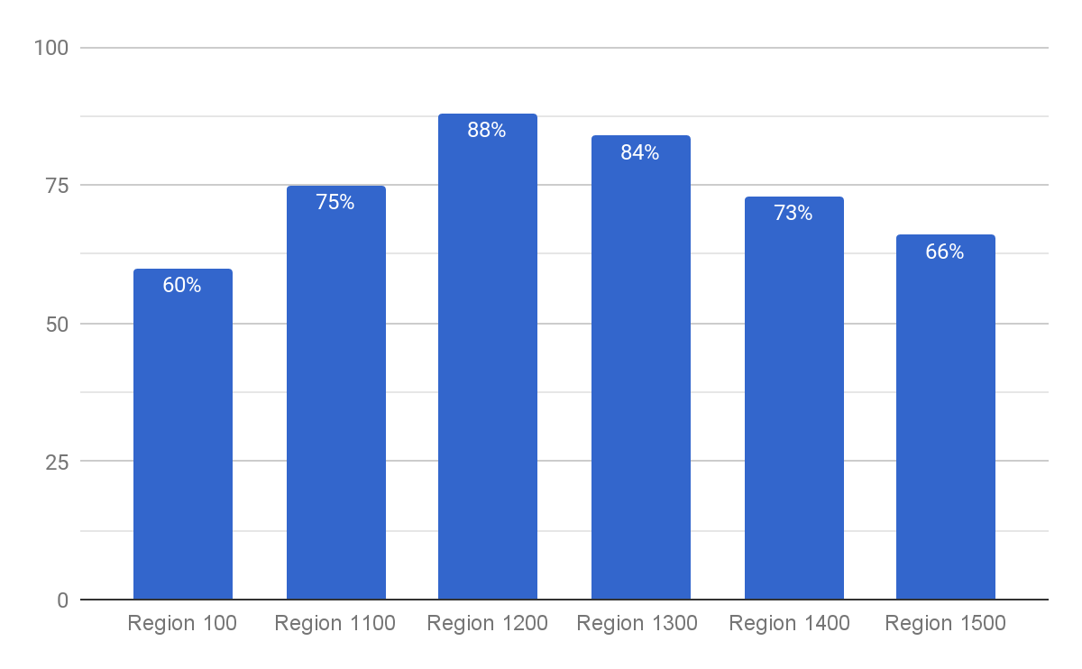
MYSTERY SHOP TOP OPPORTUNITY - REGIONS
(Fast & Friendly) Were all refrigerated beverage (soda, beer, juice, milk, vault) doors well stocked? (4pts)

Slide 27
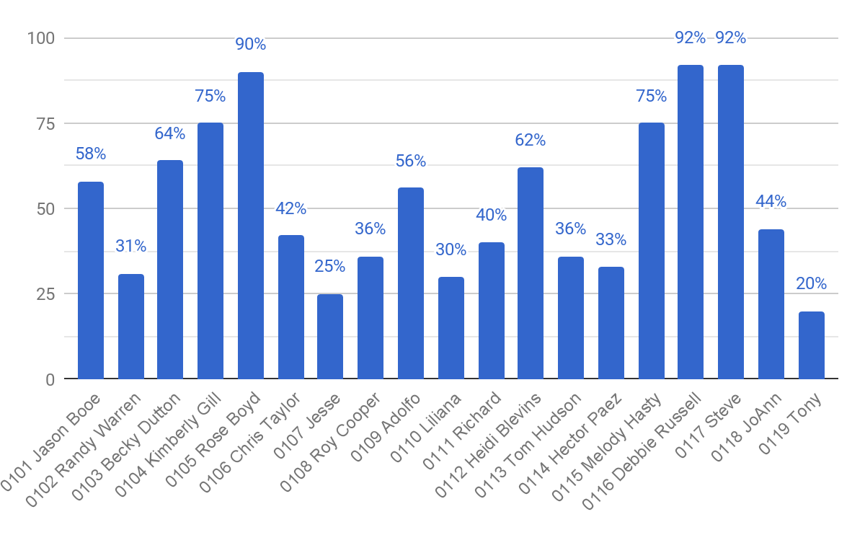
MYSTERY SHOP TOP OPPORTUNITY – REGION 100
(Fast & Friendly) Were all refrigerated beverage
(soda, beer, juice, milk, vault) doors well stocked? (4pts)

Slide 28
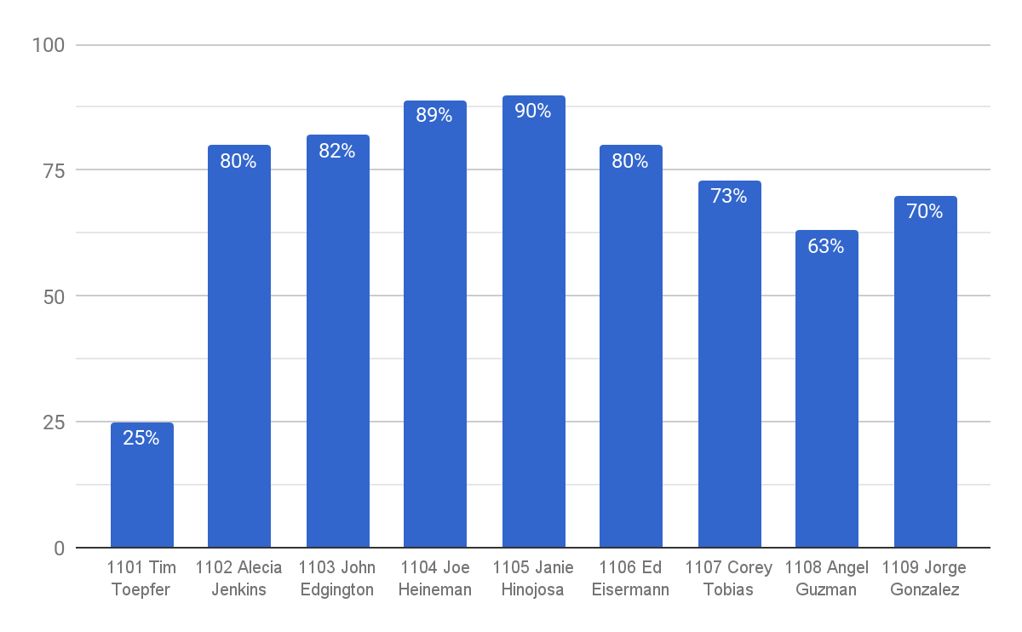
MYSTERY SHOP TOP OPPORTUNITY – REGION 1100
(Fast & Friendly) Were all refrigerated beverage
(soda, beer, juice, milk, vault) doors well stocked? (4pts)

Slide 29
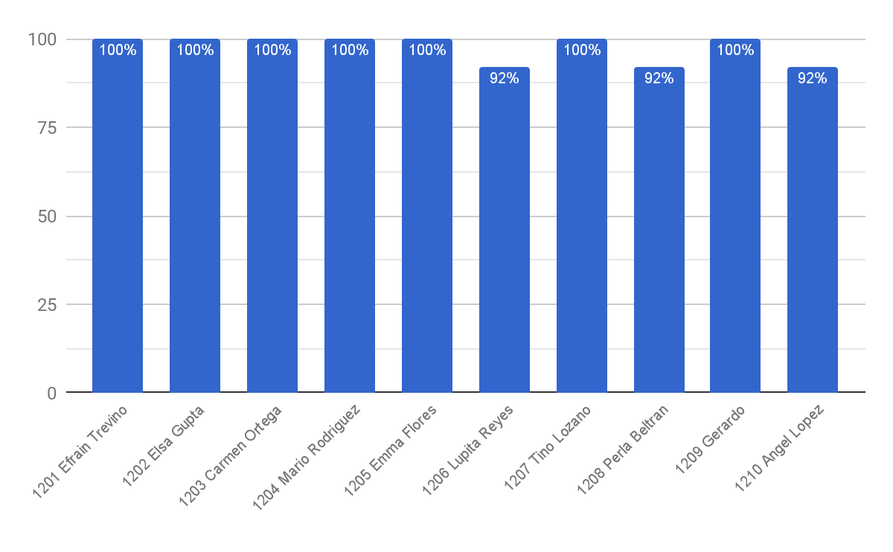
MYSTERY SHOP TOP OPPORTUNITY – REGION 1200
(Fast & Friendly) Were all refrigerated beverage
(soda, beer, juice, milk, vault) doors well stocked? (4pts)

Slide 30
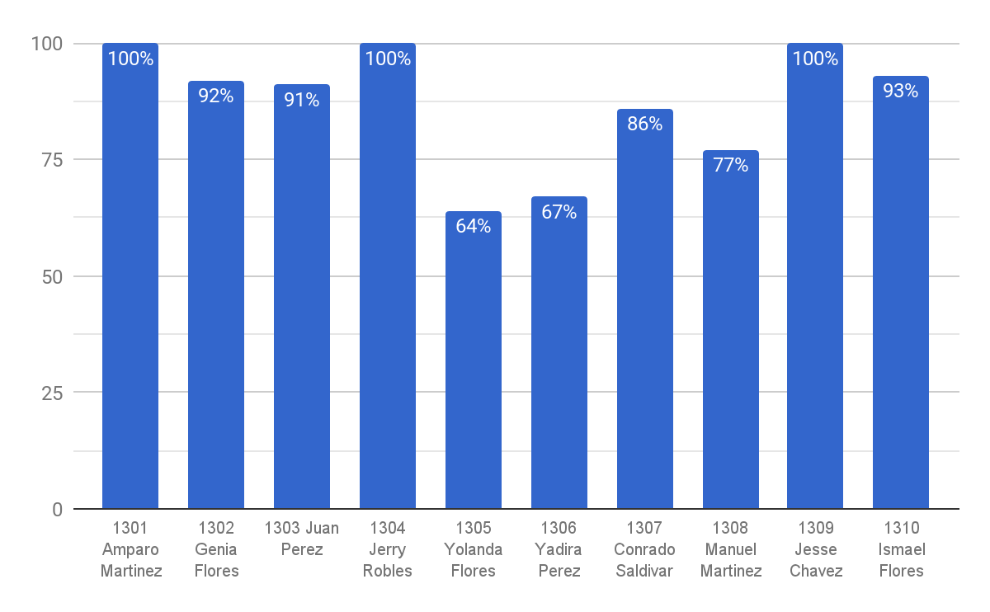
MYSTERY SHOP TOP OPPORTUNITY – REGION 1300
(Fast & Friendly) Were all refrigerated beverage (soda, beer, juice, milk, vault) doors well stocked? (4pts)

Slide 31
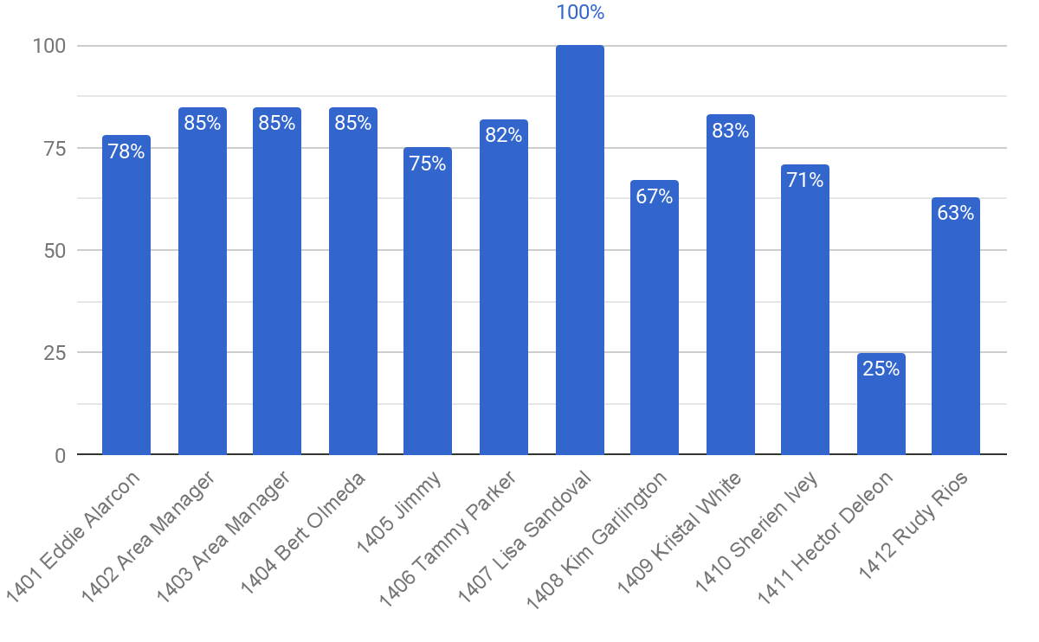
MYSTERY SHOP TOP OPPORTUNITY – REGION 1400
(Fast & Friendly) Were all refrigerated beverage (soda, beer, juice, milk, vault) doors well stocked? (4pts)

Slide 32
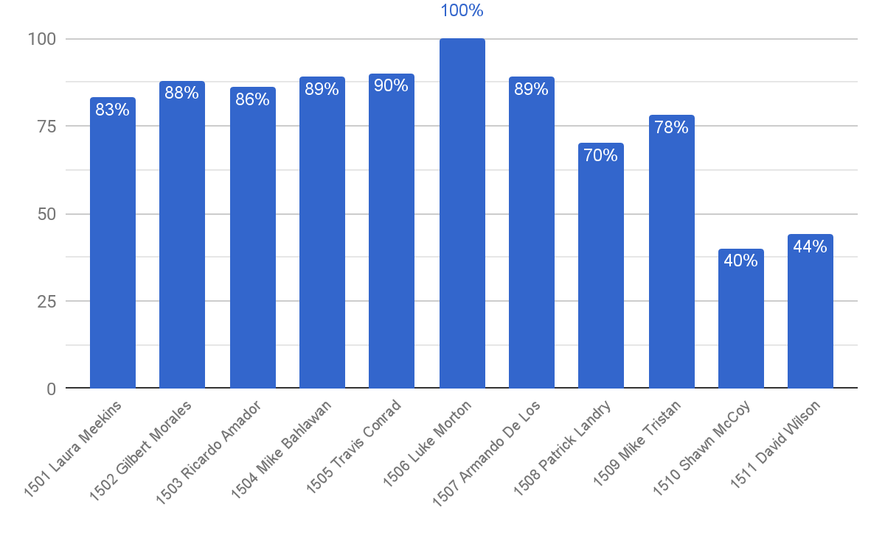
MYSTERY SHOP TOP OPPORTUNITY – REGION 1500
(Fast & Friendly) Were all refrigerated beverage (soda, beer, juice, milk, vault) doors well stocked? (4pts)

Slide 33
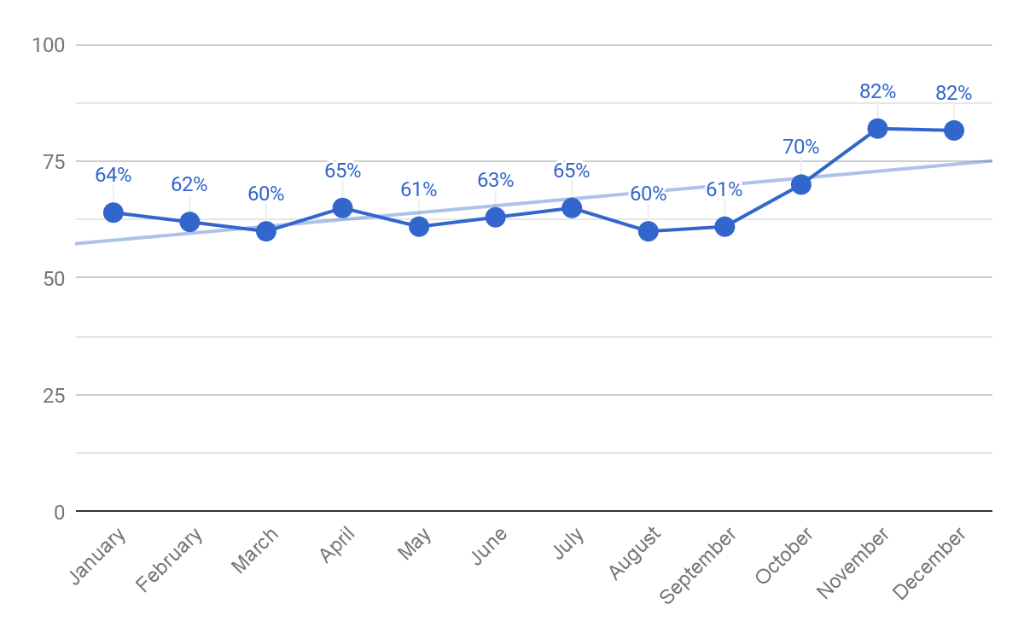
MYSTERY SHOP TOP OPPORTUNITY – TREND
(Clean & Safe) Were the restrooms clean? (3pts)

Slide 34
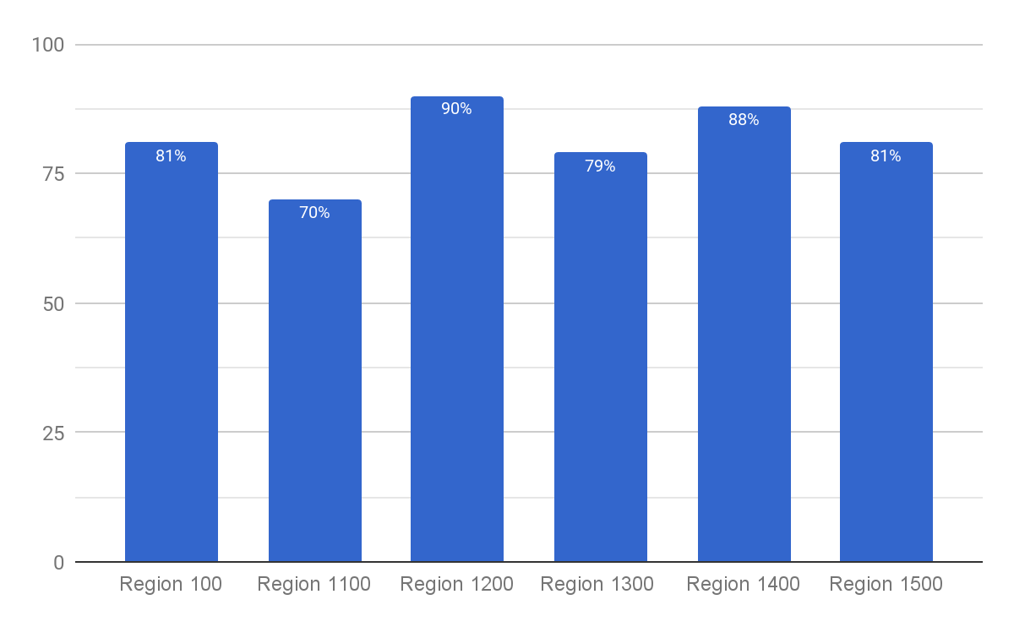
MYSTERY SHOP TOP OPPORTUNITY – DECEMBER
(Clean & Safe) Were the restrooms clean? (3pts)

Slide 35
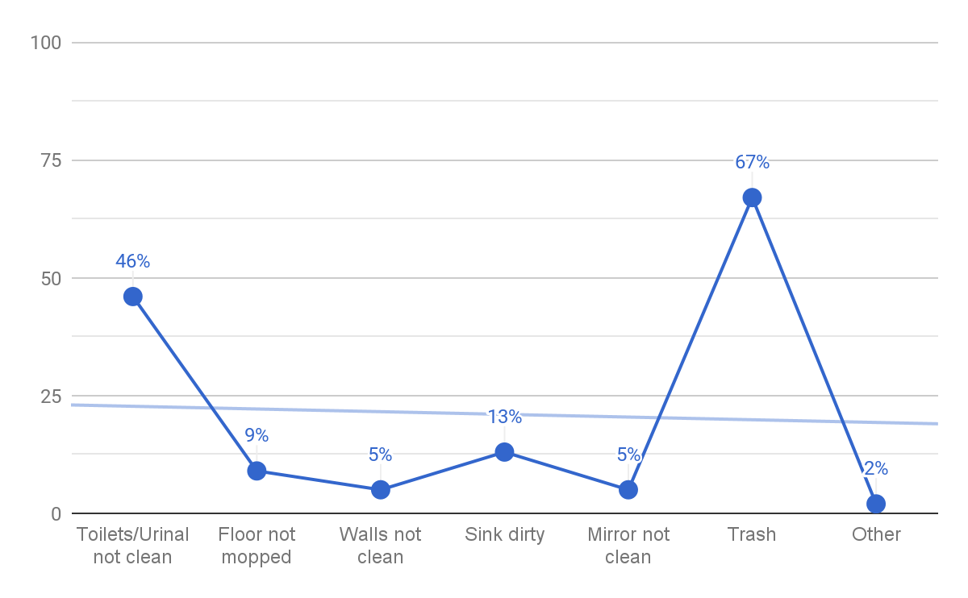
MYSTERY SHOP TOP OPPORTUNITY - DECEMBER
(Clean & Safe) Were the restrooms clean? (3pts)
If no, please explain what was not clean:

Slide 36
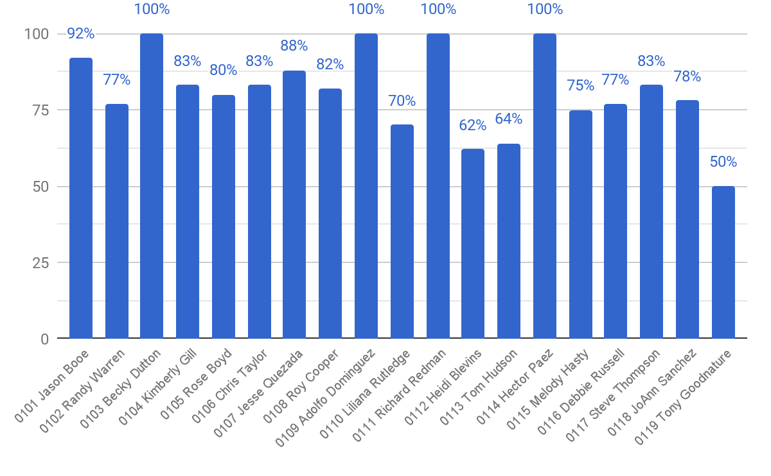
MYSTERY SHOP TOP OPPORTUNITY – REGION 100
(Clean & Safe) Were the restrooms clean? (3pts)

Slide 37
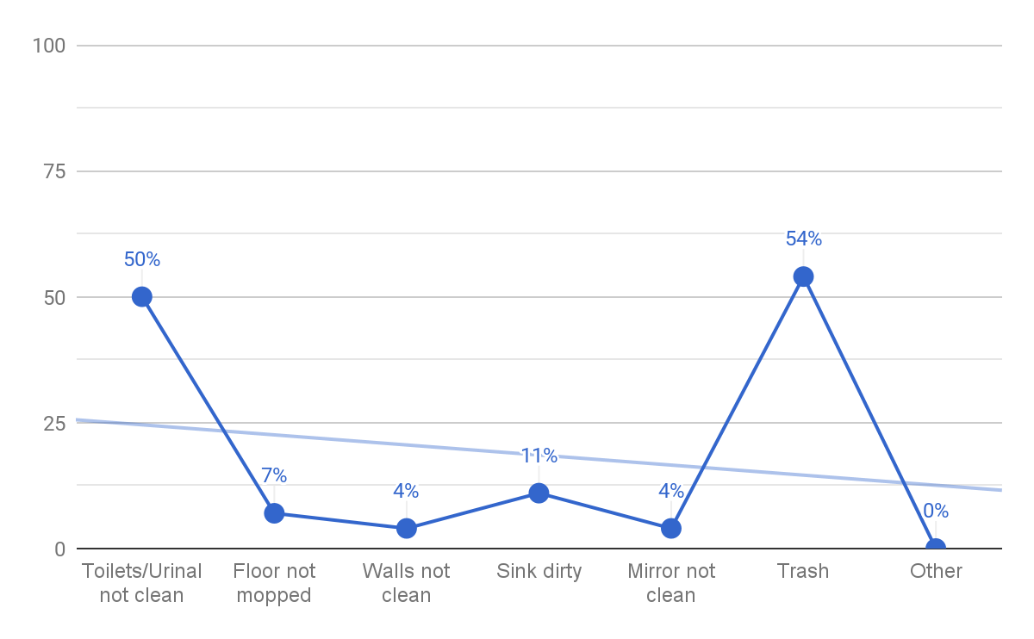
MYSTERY SHOP TOP OPPORTUNITY – REGION 100
(Clean & Safe) Were the restrooms clean? (3pts)
If no, please explain what was not clean:

Slide 38
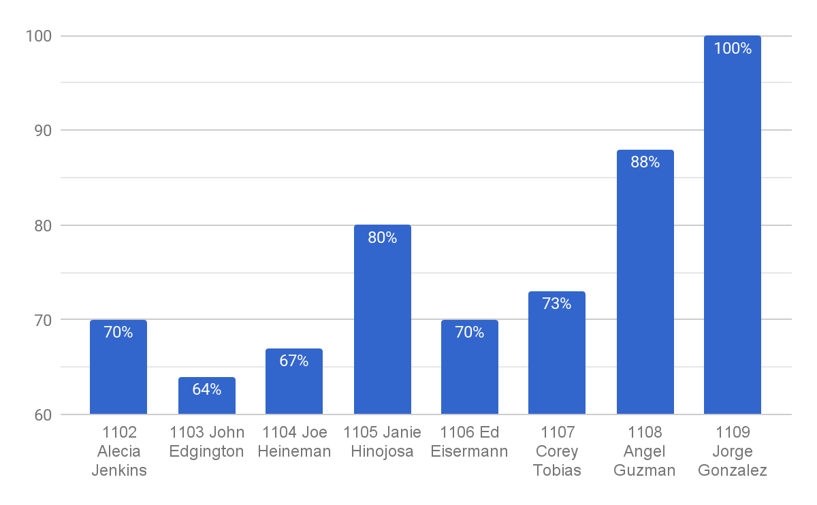
MYSTERY SHOP TOP OPPORTUNITY – REGION 1100
(Clean & Safe) Were the restrooms clean? (3pts)

Slide 39
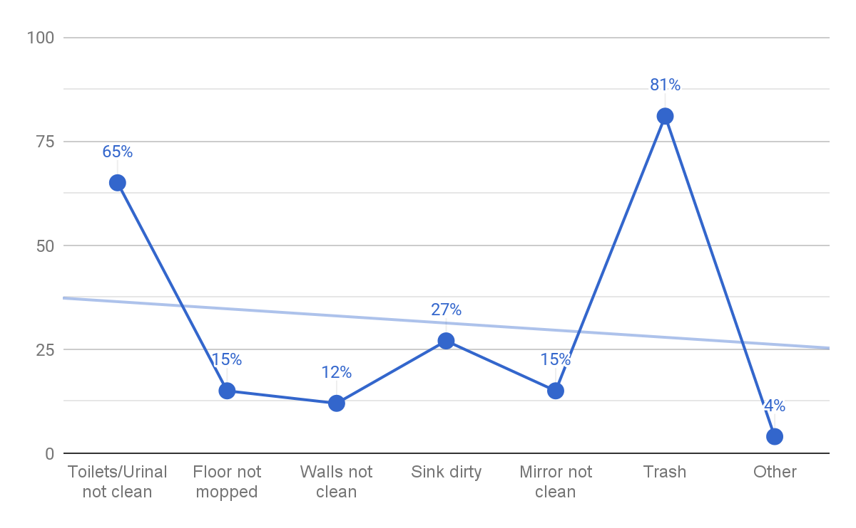
MYSTERY SHOP TOP OPPORTUNITY – REGION 1100
(Clean & Safe) Were the restrooms clean? (3pts)
If no, please explain what was not clean:

Slide 40
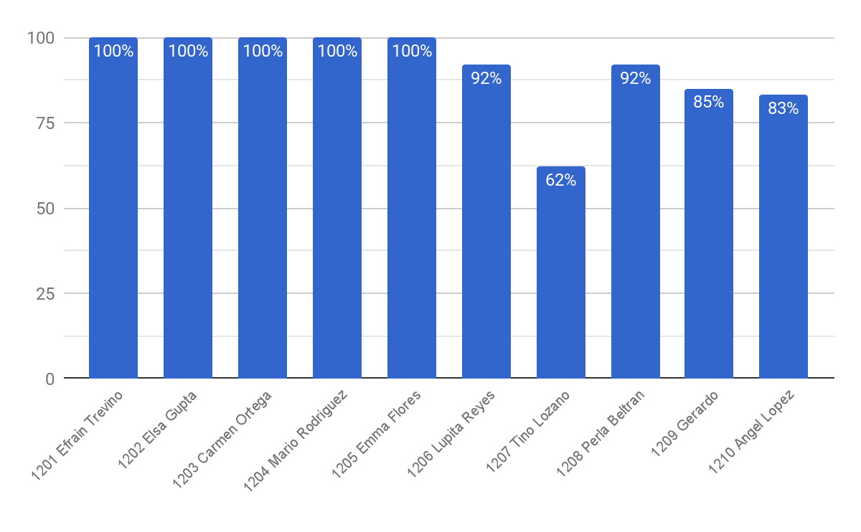
MYSTERY SHOP TOP OPPORTUNITY – REGION 1200
(Clean & Safe) Were the restrooms clean? (3pts)

Slide 41
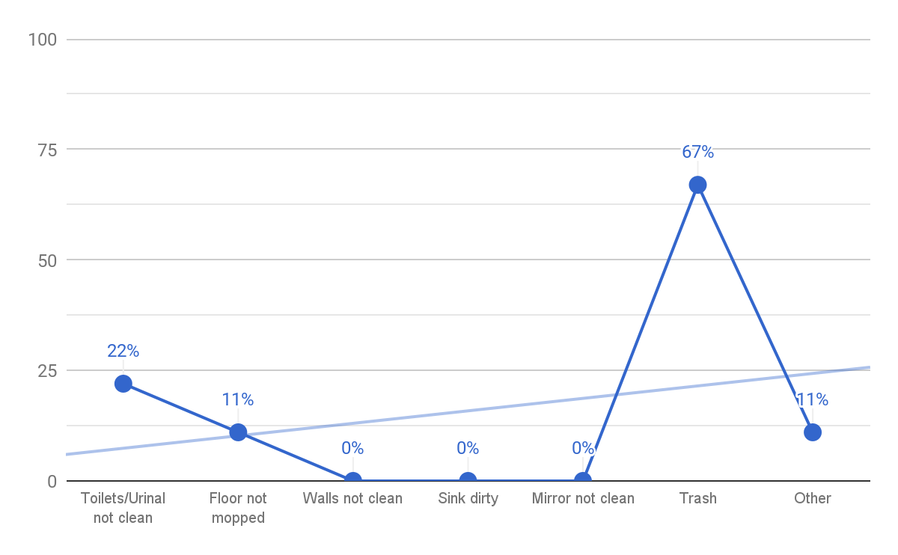
MYSTERY SHOP TOP OPPORTUNITY – REGION 1200
(Clean & Safe) Were the restrooms clean? (3pts)
If no, please explain what was not clean:

Slide 42
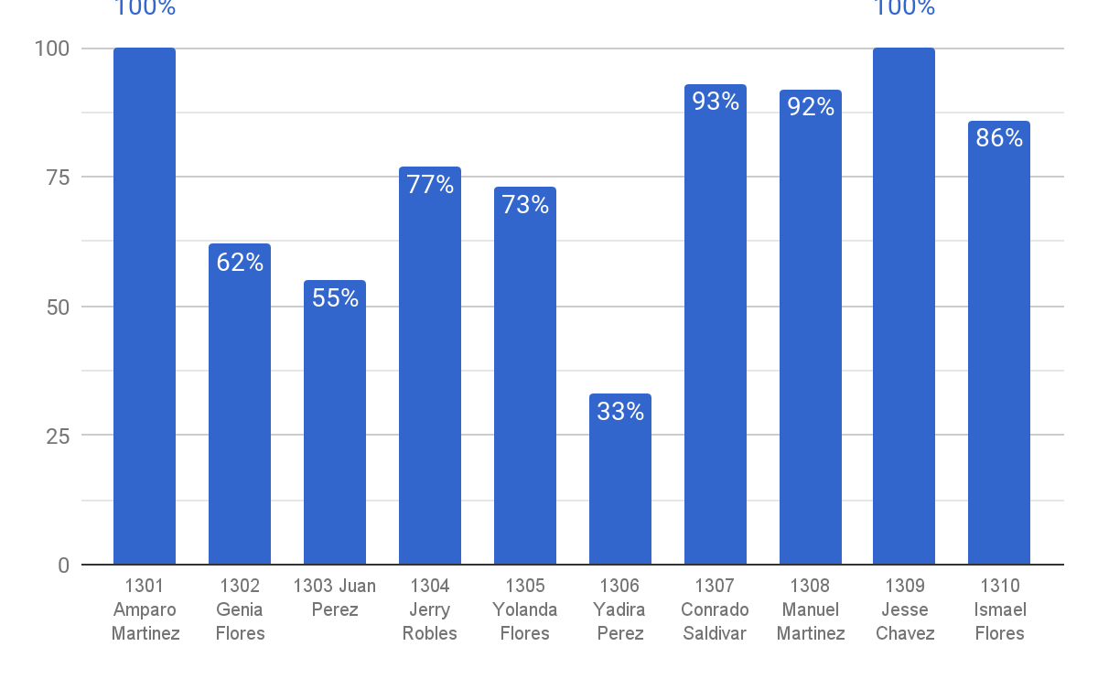
MYSTERY SHOP TOP OPPORTUNITY – REGION 1300
(Clean & Safe) Were the restrooms clean? (3pts)

Slide 43
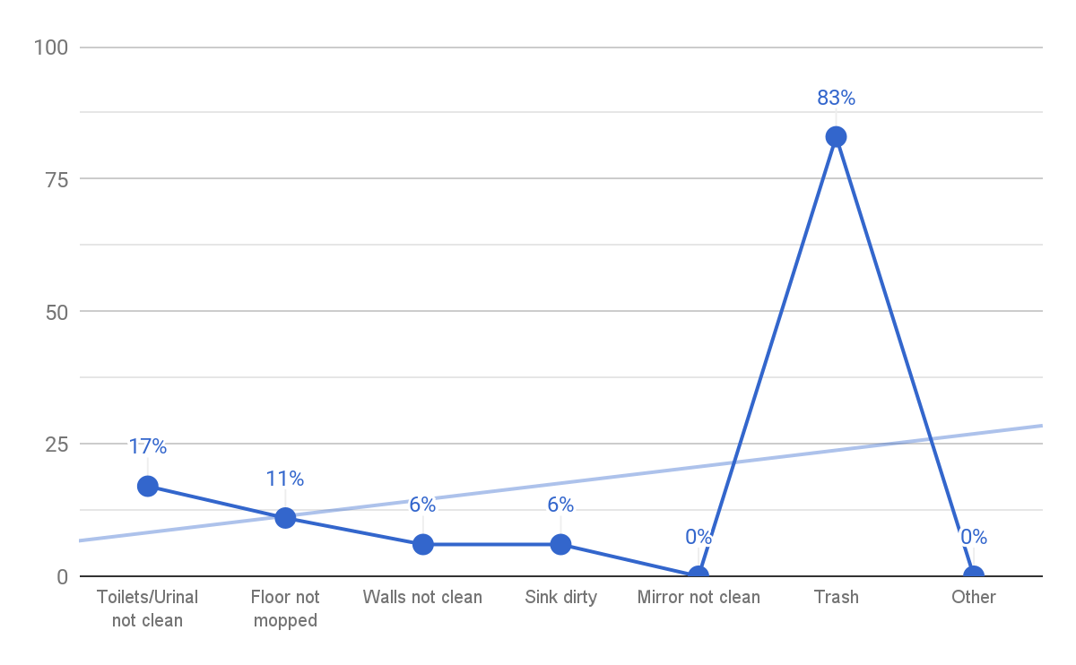
MYSTERY SHOP TOP OPPORTUNITY – REGION 1300
(Clean & Safe) Were the restrooms clean? (3pts)
If no, please explain what was not clean:

Slide 44
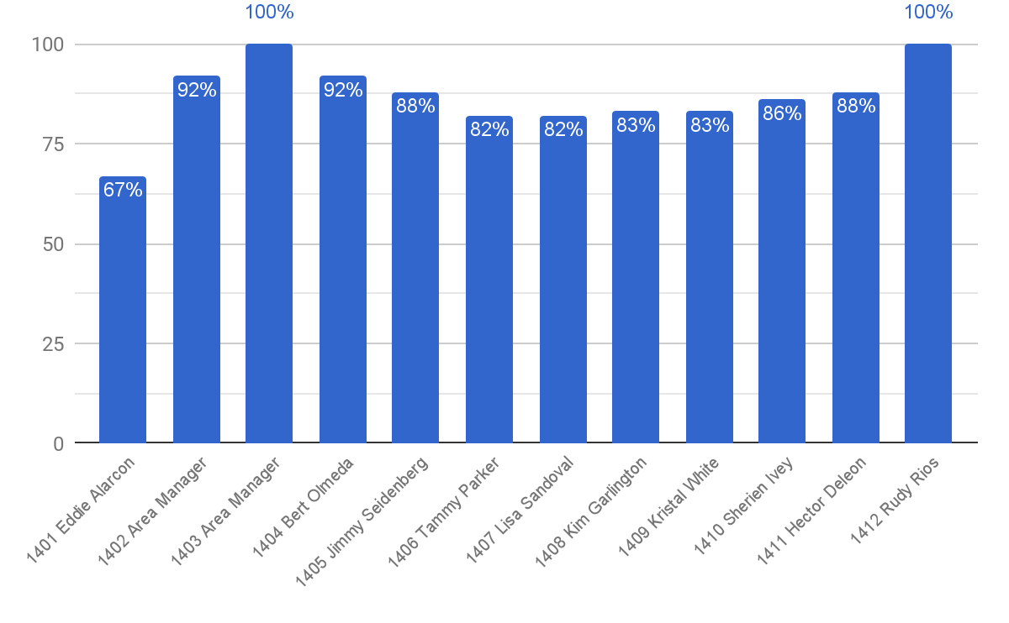
MYSTERY SHOP TOP OPPORTUNITY – REGION 1400
(Clean & Safe) Were the restrooms clean? (3pts)

Slide 45
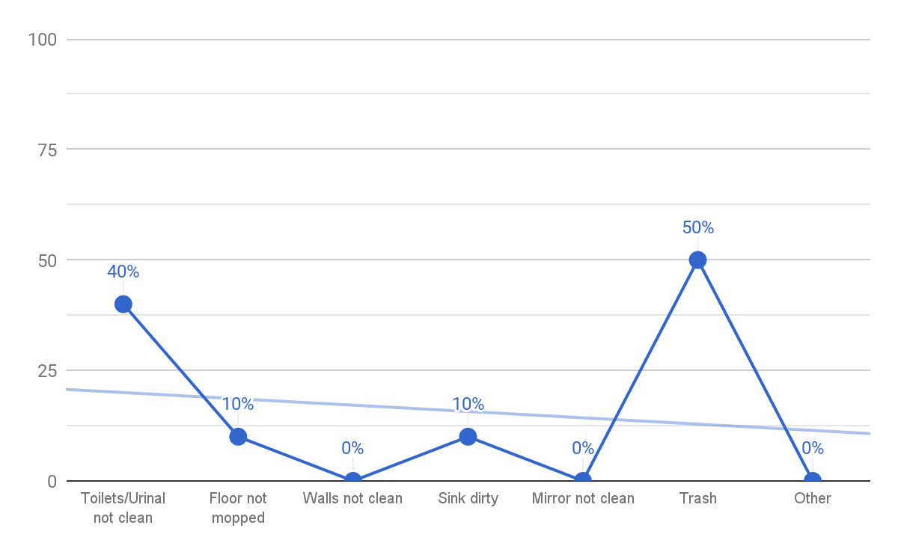
MYSTERY SHOP TOP OPPORTUNITY – REGION 1400
(Clean & Safe) Were the restrooms clean? (3pts)
If no, please explain what was not clean:

Slide 46
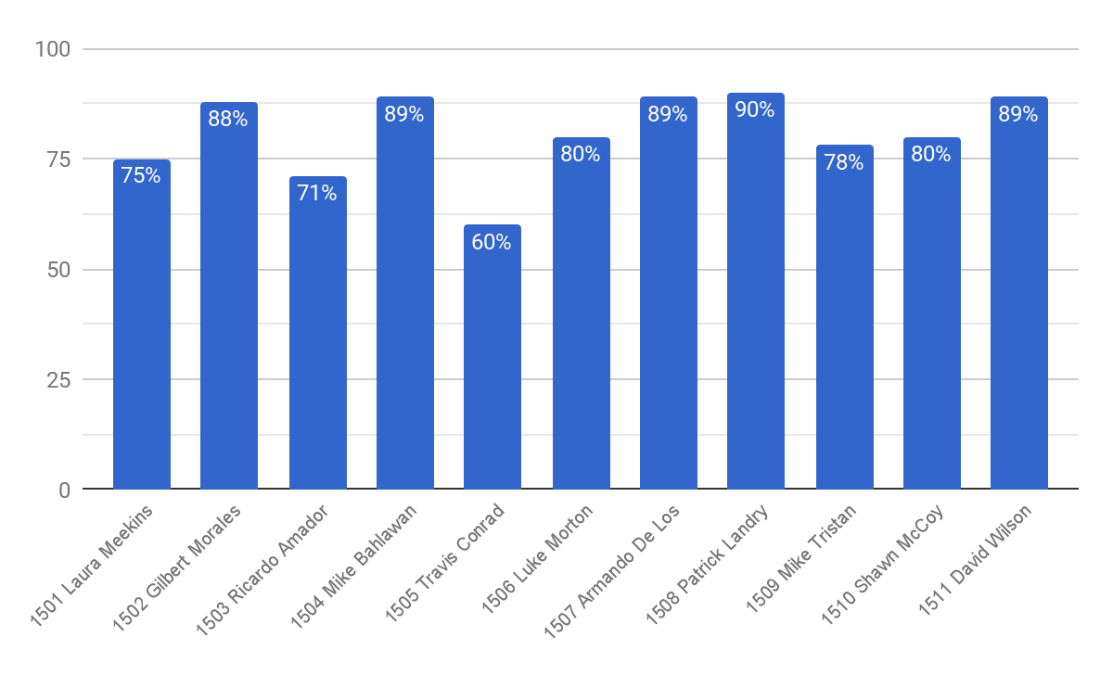
MYSTERY SHOP TOP OPPORTUNITY – REGION 1500
(Clean & Safe) Were the restrooms clean? (3pts)

Slide 47
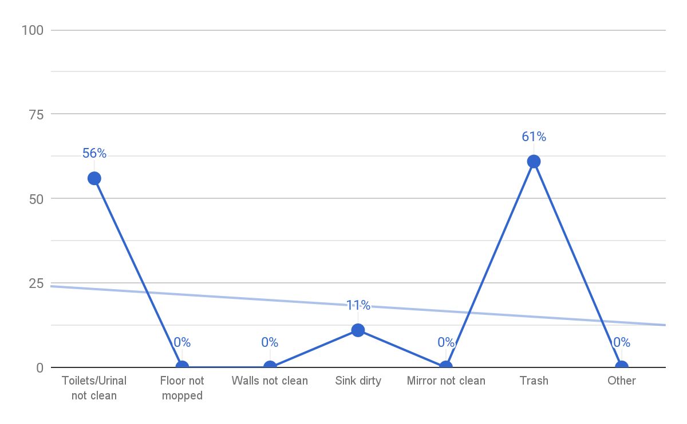
MYSTERY SHOP TOP OPPORTUNITY – REGION 1500
(Clean & Safe) Were the restrooms clean? (3pts)
If no, please explain what was not clean:

Slide 48
MYSTERY SHOP – TOP PERFORMING AREA MANAGERS
Rank | Area | Evaluations | Average
 |  |  | Score %
1 | 1209 Gerardo Espronceda | 11 | 96.85
2 | 1202 Elsa Gupta | 9 | 96.60
3 | 1204 Mario Rodriguez | 11 | 96.00
4 | 1301 Amparo Martinez | 14 | 94.45
5 | 1203 Carmen Ortega | 13 | 94.27
6 | 1210 Angel Lopez | 11 | 94.08
7 | 1404 Bert Olmeda | 12 | 93.23
8 | 1208 Perla Beltran | 10 | 92.08
9 | 1104 Joe Heineman | 11 | 91.89
10 | 1506 Luke Morton | 9 | 91.40

Slide 49
MYSTERY SHOP – BOTTOM PERFORMING AREA MANAGERS
Rank | Area | Evaluations | Average
 |  |  | Score %
62 | 113 Tom Hudson | 8 | 77.45
63 | 111 Richard Redman | 9 | 77.30
64 | 1411 Hector Deleon | 10 | 76.88
65 | 1510 Shawn McCoy | 11 | 76.40
66 | 119 Tony Goodnature | 10 | 76.10
67 | 110 Liliana Rutledge | 11 | 74.40
68 | 118 JoAnn Sanchez | 13 | 73.67
69 | 1101 Tim Toepfer | 8 | 73.13
70 | 107 Jesse Quezada | 7 | 71.13
71 | 108 Roy Cooper | 5 | 70.91

