Slide 1
MYSTERY SHOP UPDATE
January/February 2018

Slide 2
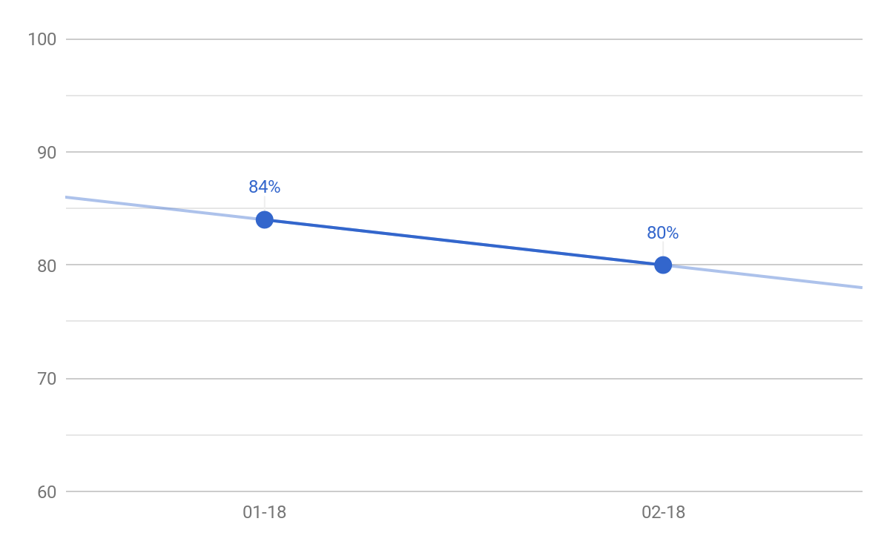
TEAM HORIZON - MYSTERY SHOP SCORING
Notes:
NEW

Slide 3
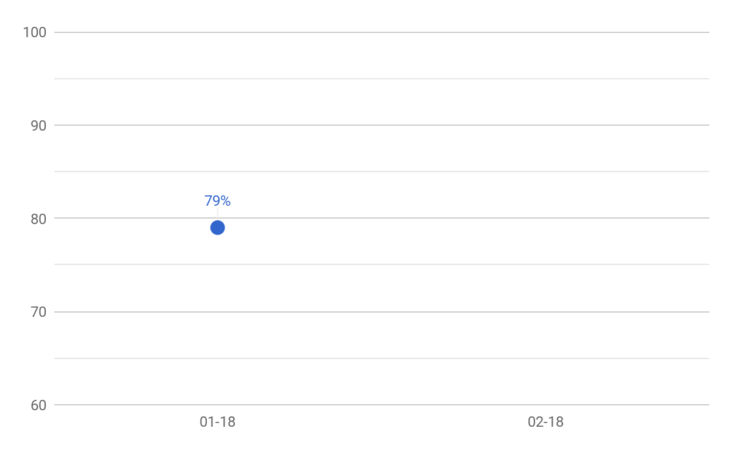
REGION 1100 - MYSTERY SHOP SCORING

Slide 4
REGION 1100 - BOTTOM STORES TREND
Area Manager | January | February
Area 1102 - John Edgington | 79% | --
Area 1104 - Joe Heineman | 78% | --
Area 1101 - Tim Toepfer | 77% | --
Area 1109 - Jorge Gonzalez | 77% | --
Area 1108 - Angel Guzman | 73% | --

Slide 5
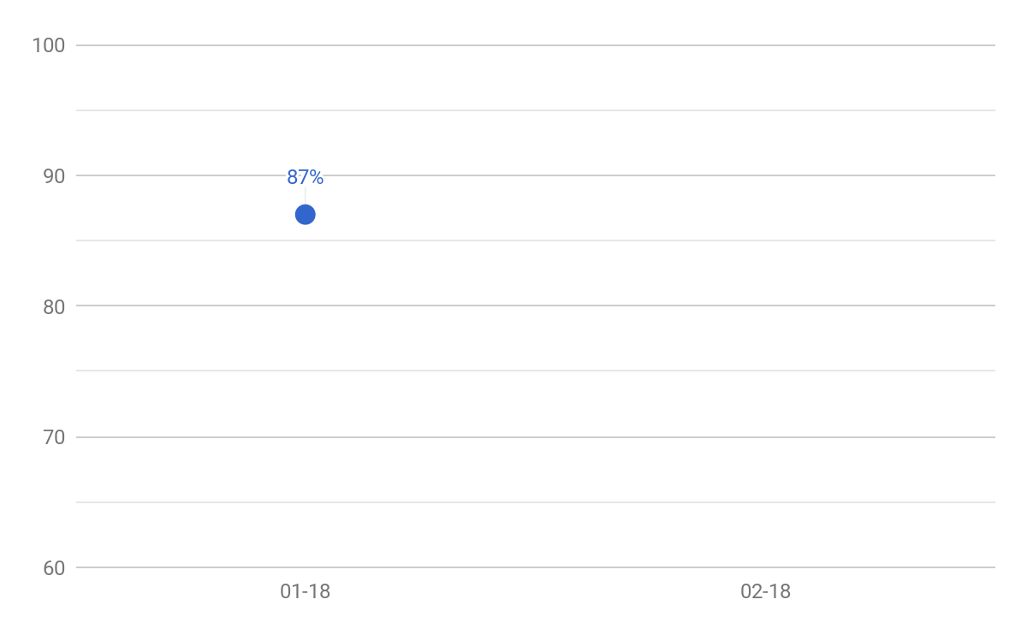
REGION 1200 - MYSTERY SHOP SCORING

Slide 6
REGION 1200 - BOTTOM STORES TREND
Area Manager | January | February
Area 1206 - Amparo Martinez | 88% | --
Area 1210 - Angel Lopez | 86% | --
Area 1209 - Gerardo Espronceda | 85% | --
Area 1208 - Perla Beltran | 84% | --
Area 1207 - Tino Lozano | 79% | --

Slide 7
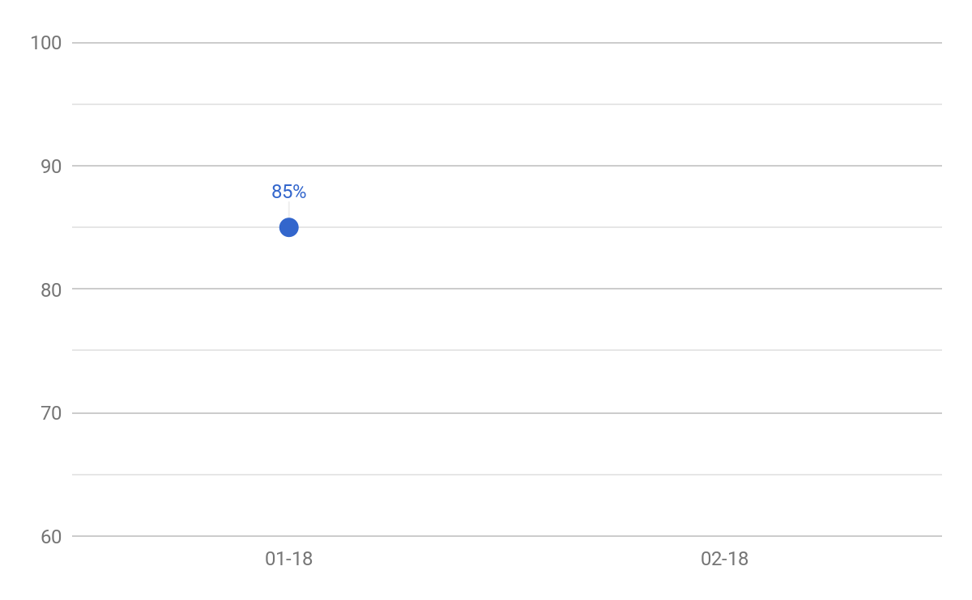
REGION 1300 - MYSTERY SHOP SCORING

Slide 8
REGION 1300 - BOTTOM STORES TREND
Area Manager | January | February
Area 1303 - Juan Perez | 83% | --
Area 1305 - Yolanda Flores | 83% | --
Area 1308 - Manuel Martinez | 83% | --
Area 1306 - Yadira Perez | 80% | --
Area 1304 - Jerry Robles | 79% | --

Slide 9
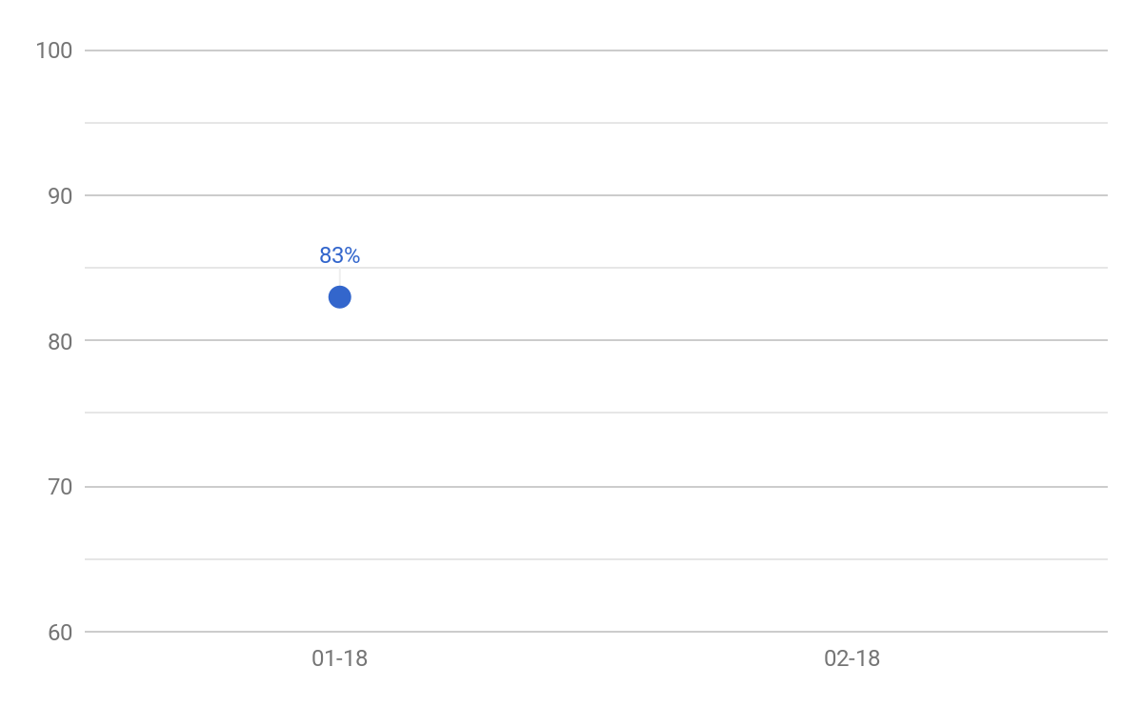
REGION 1400 - MYSTERY SHOP SCORING

Slide 10
REGION 1400 - BOTTOM STORES
Area Manager | January | February
Area 1404 - Bert Olmeda | 84% | --
Area 1401 - Eddie Alarcon | 80% | --
Area 1408 - Kim Garlington | 79% | --
Area 1411 - Hector DeLeon | 79% | --
Area 1402 - Pamela Brumley | 74% | --

Slide 11
REGION 1500 - MYSTERY SHOP SCORING

Slide 12
REGION 1500 - BOTTOM STORES
Area Manager | January | February
Area 1507 - Armando de los Santos | 80% | --
Area 1511 - David Wilson | 80% | --
Area 1509 - Michael Tristan | 79% | --
Area 1508 - Patrick Landry | 78% | --
Area 1510 - Area Manager 1510 | 78% | --

Slide 13
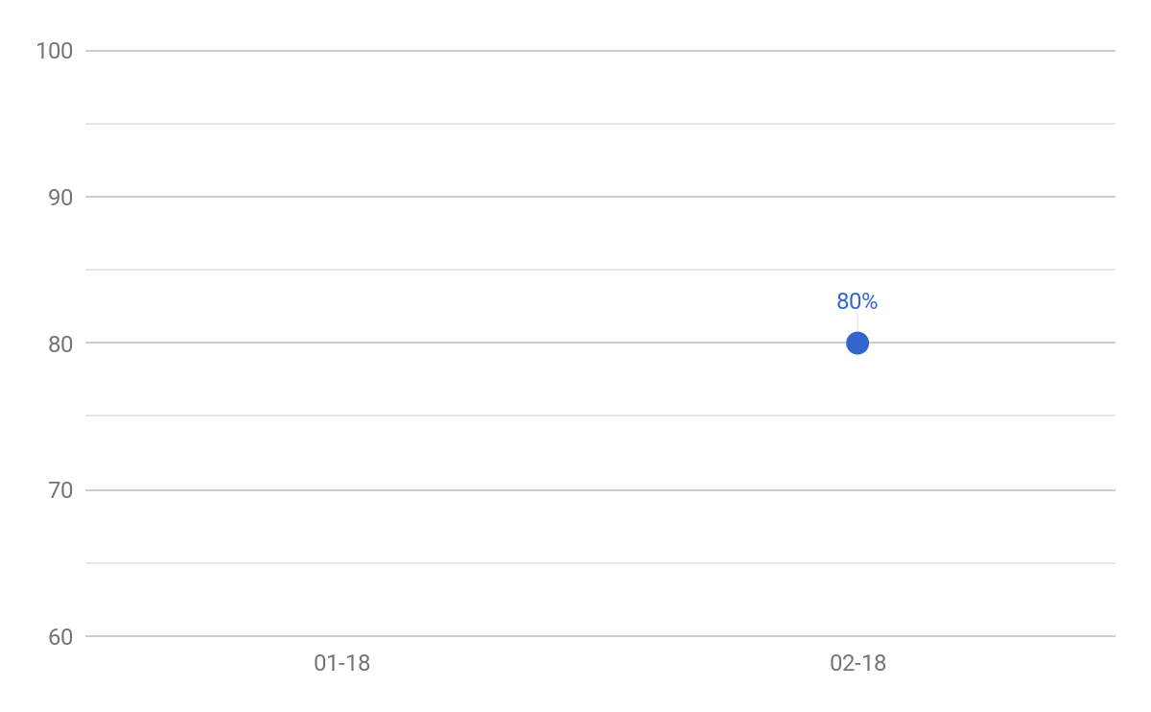
REGION 1600 - MYSTERY SHOP SCORING

Slide 14
REGION 1600 - BOTTOM STORES
Area Manager | January | February
Area 1605 - David McNair | -- | 77%
Area 1609 - Brian Doyle | -- | 77%
Area 1611 - Maria Nivelo | -- | 77%
Area 1604 - Ernest Jones | -- | 76%
Area 1610 - Greg Scott | -- | 73%

Slide 15
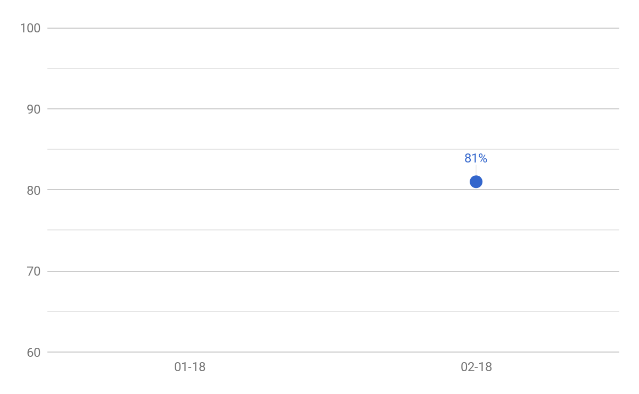
REGION 1700 - MYSTERY SHOP SCORING

Slide 16
REGION 1700 - BOTTOM STORES
Area Manager | January | February
Area 1709 - Lorraine L. Giles | -- | 82%
Area 1706 - Keith Ackerman | -- | 81%
Area 1705 - Jody Sauls | -- | 79%
Area 1704 - Shelley Ross | -- | 76%
Area 1710 - Leon Bailey | -- | 73%

Slide 17
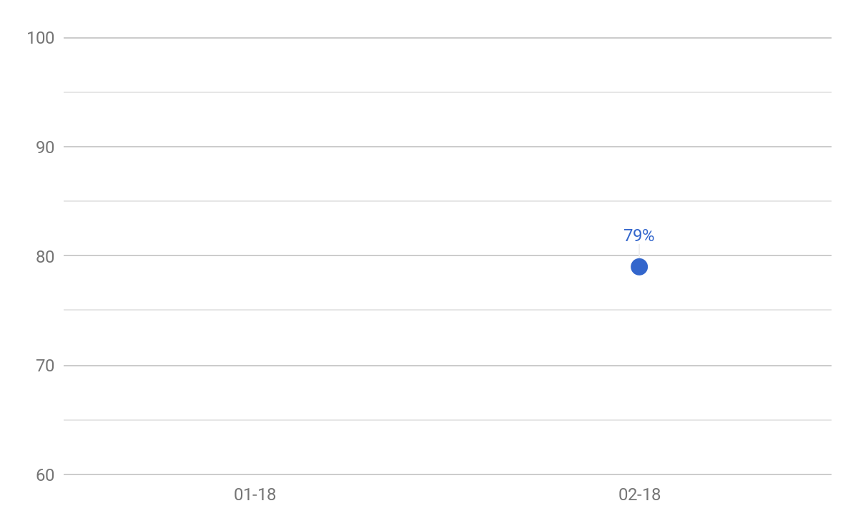
REGION 1800 - MYSTERY SHOP SCORING

Slide 18
REGION 1800 - BOTTOM STORES
Area Manager | January | February
Area 1803 - Scott Drozdowski | -- | 80%
Area 1802 - Christopher Weston | -- | 78%
Area 1805 - Doug T. Bernard | -- | 78%
Area 1808 - John Kosiak | -- | 78%
Area 1806 - Jesse J. Albright | -- | 77%

Slide 19
REGION 1900 - MYSTERY SHOP SCORING

Slide 20
REGION 1900 - BOTTOM STORES
Area Manager | January | February
Area 1902 - Pamela Leach | -- | 79%
Area 1910 - Denise D. Vandine | -- | 78%
Area 1906 - Robert E. May | -- | 77%
Area 1904 - Thomas A. Brown | -- | 75%
Area 1903 - Janet M. Carlini | -- | 73%

Slide 21
REGION 2000 - MYSTERY SHOP SCORING

Slide 22
REGION 2000 - BOTTOM STORES
Area Manager | January | February
Area 2006 - Barbara Yerdon | -- | 79%
Area 2009 - Melinda M. Gifford | -- | 78%
Area 2008 - Melvin L. Cooper | -- | 77%
Area 2011 - Nadeem Shakoor | -- | 76%
Area 2004 - Jennifer E. Frank | -- | 75%

Slide 23
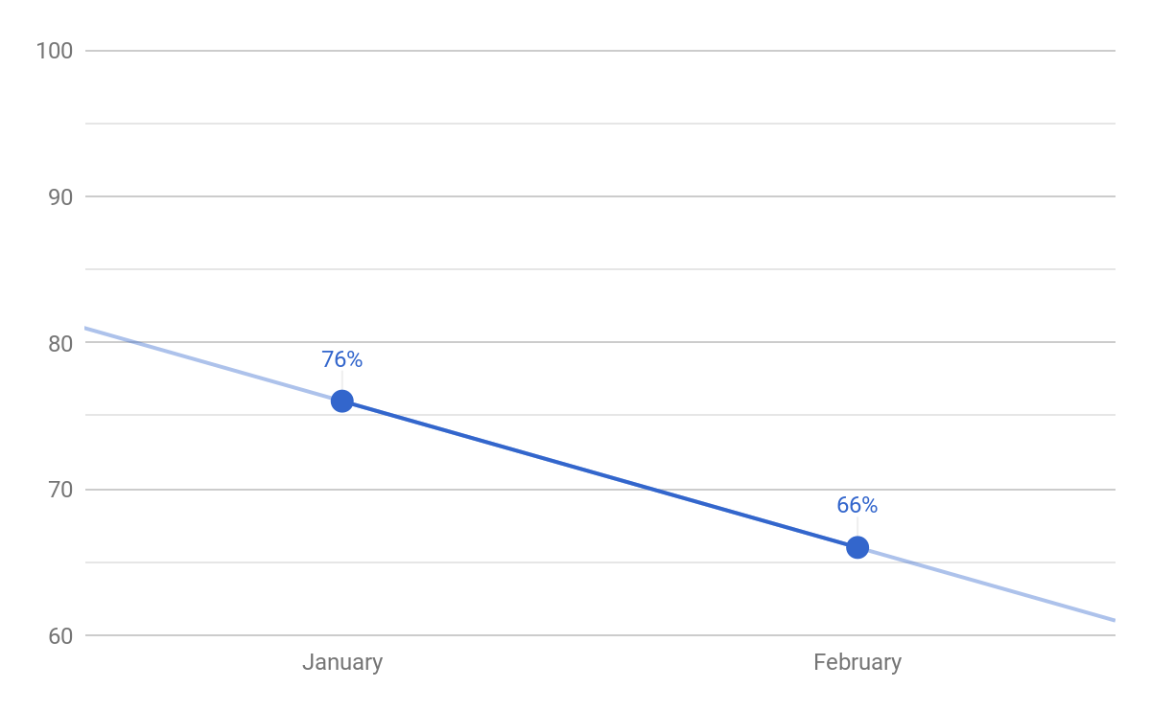
FAST & FRIENDLY - MYSTERY SHOP SCORING

Slide 24
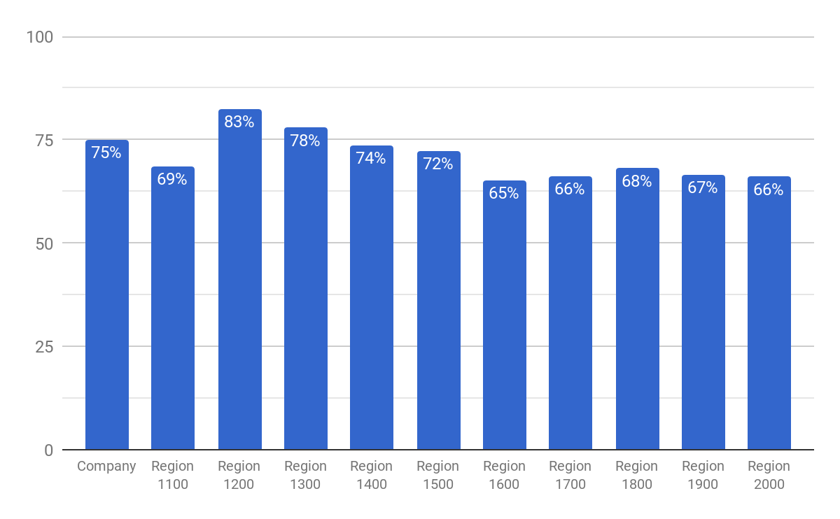
FAST & FRIENDLY - REGIONS

Slide 25
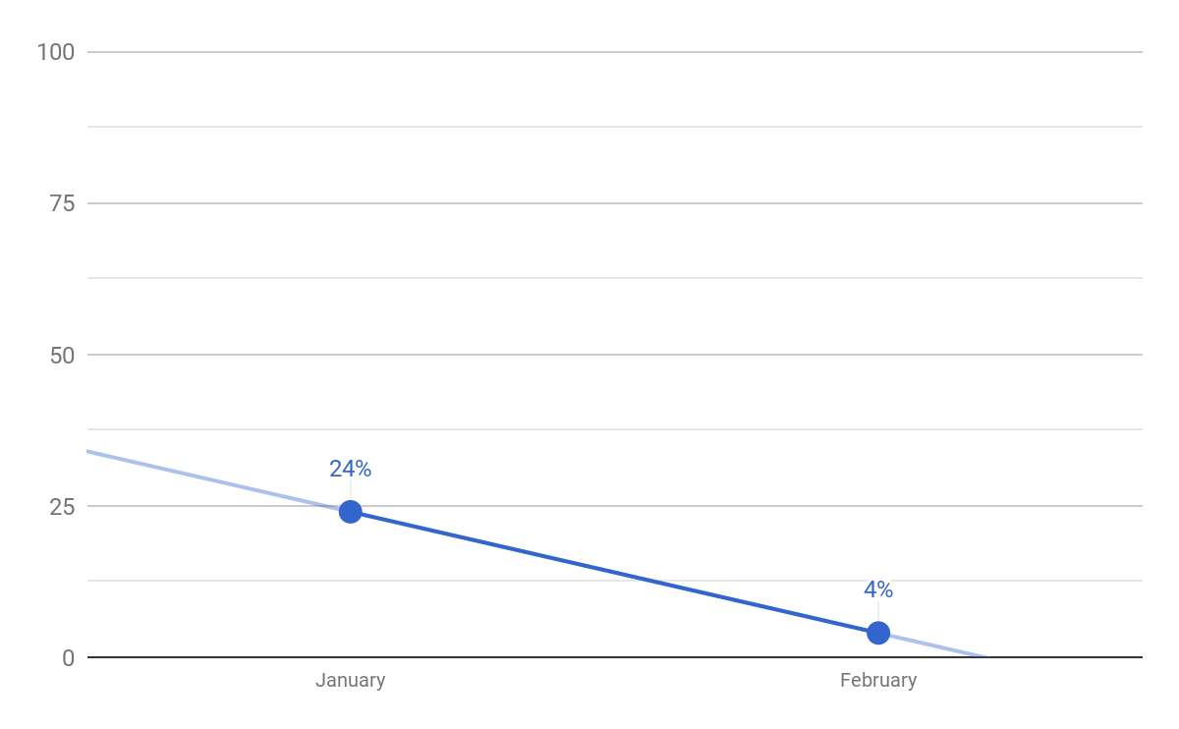
FAST & FRIENDLY UPSELL

Slide 26
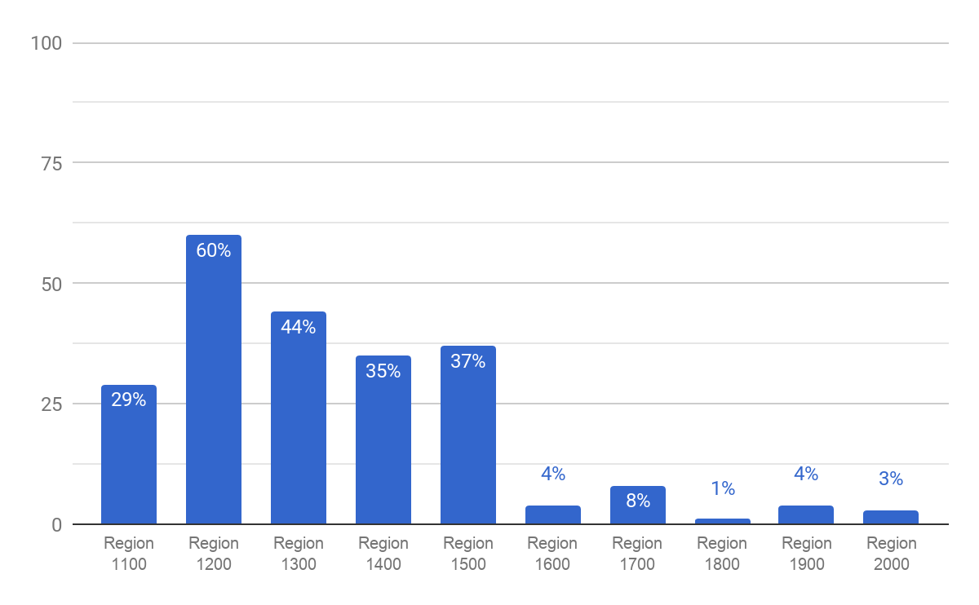
FAST & FRIENDLY UPSELL - REGIONS

Slide 27
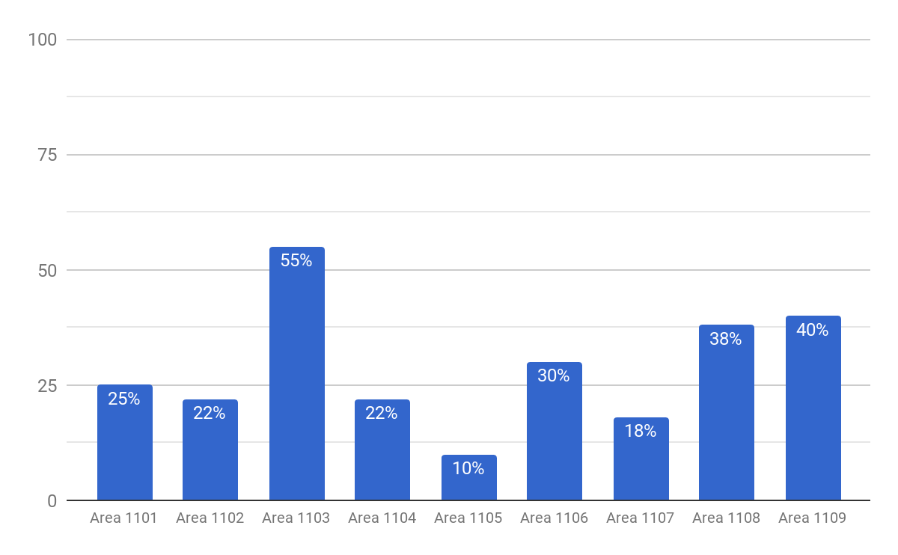
FAST & FRIENDLY UPSELL - REGION 1100

Slide 28
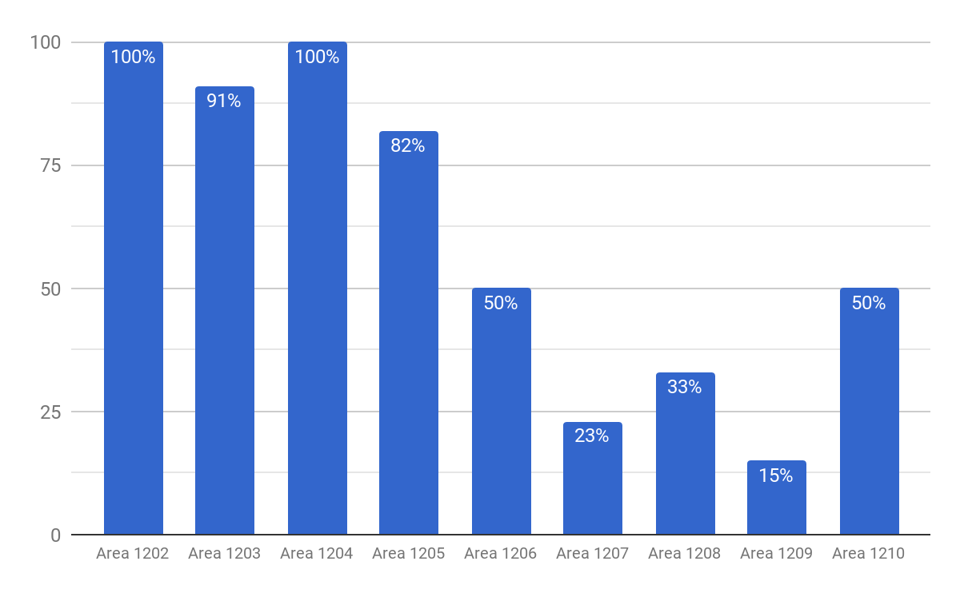
FAST & FRIENDLY UPSELL - REGION 1200

Slide 29
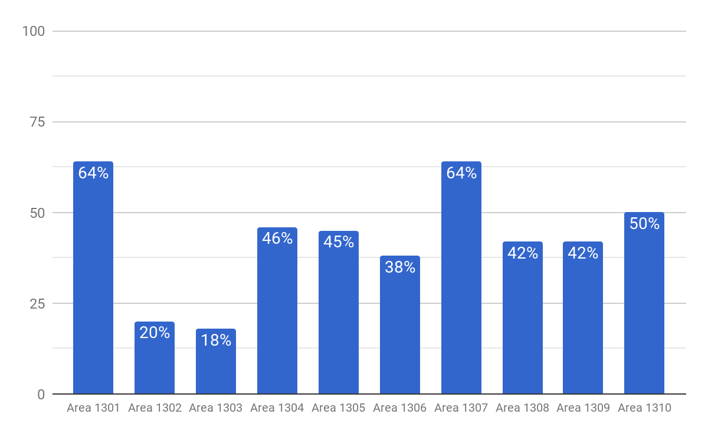
FAST & FRIENDLY UPSELL - REGION 1300

Slide 30
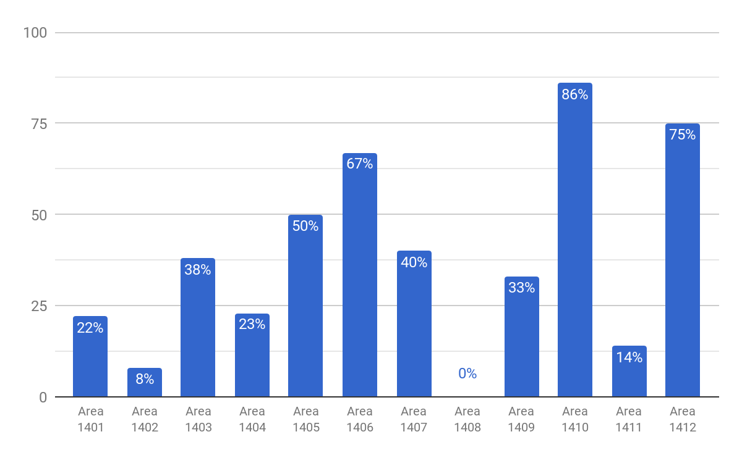
FAST & FRIENDLY UPSELL - REGION 1400

Slide 31
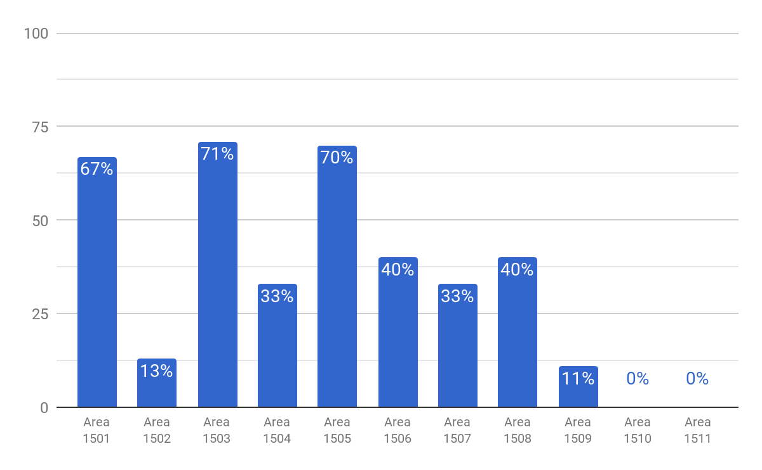
FAST & FRIENDLY UPSELL - REGION 1500

Slide 32
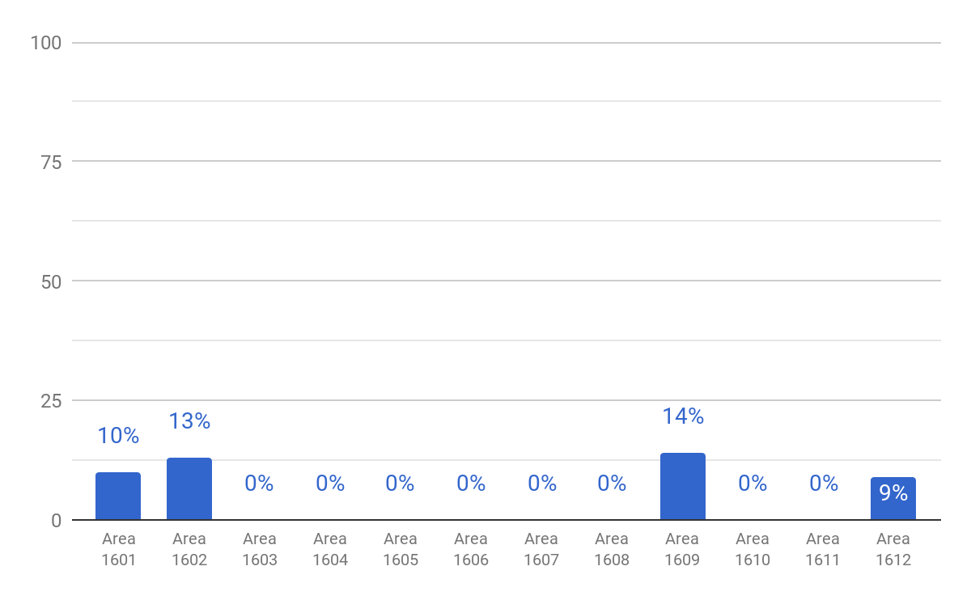
FAST & FRIENDLY UPSELL - REGION 1600

Slide 33
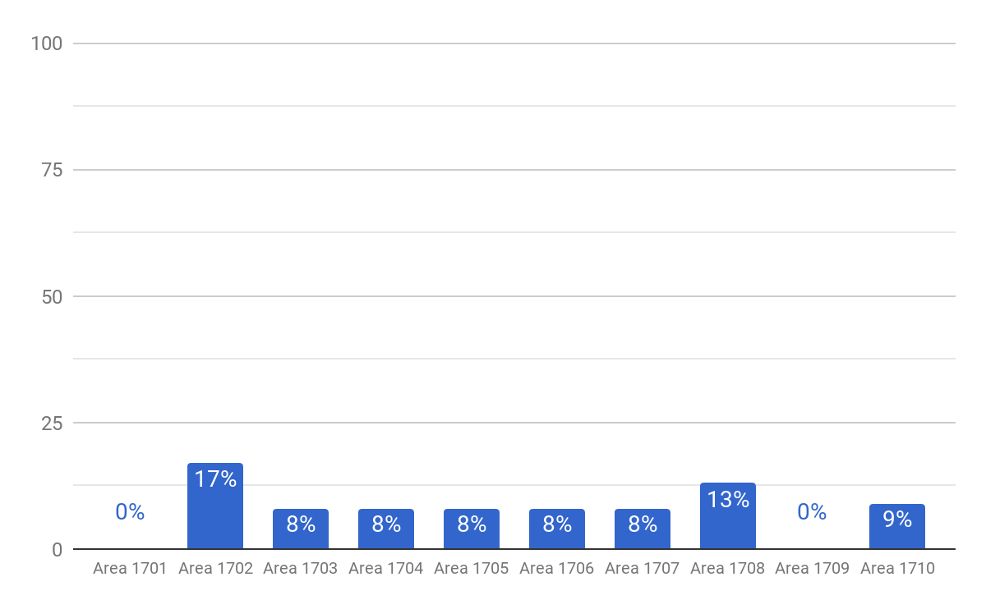
FAST & FRIENDLY UPSELL - REGION 1700

Slide 34
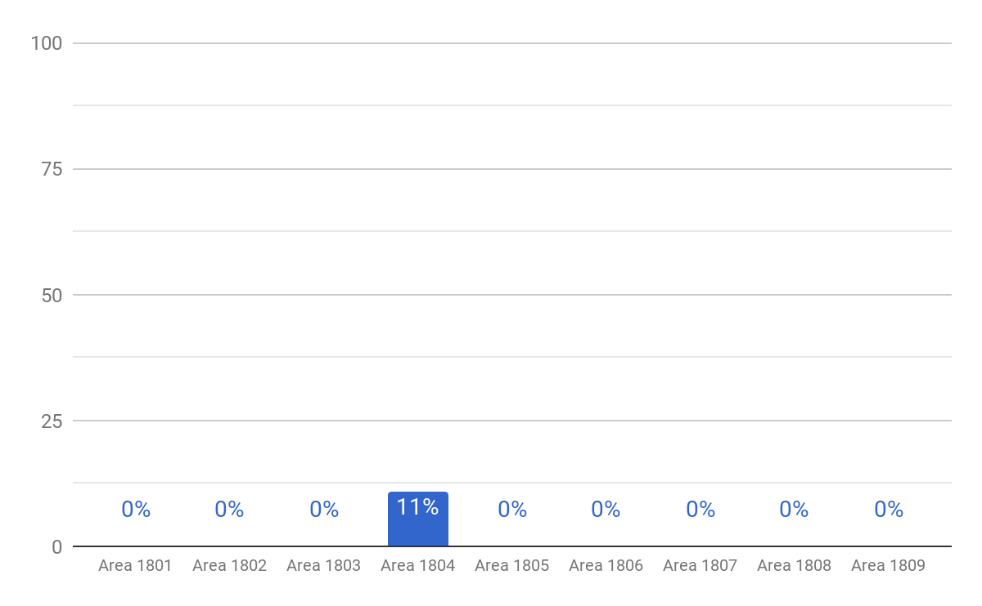
FAST & FRIENDLY UPSELL - REGION 1800

Slide 35
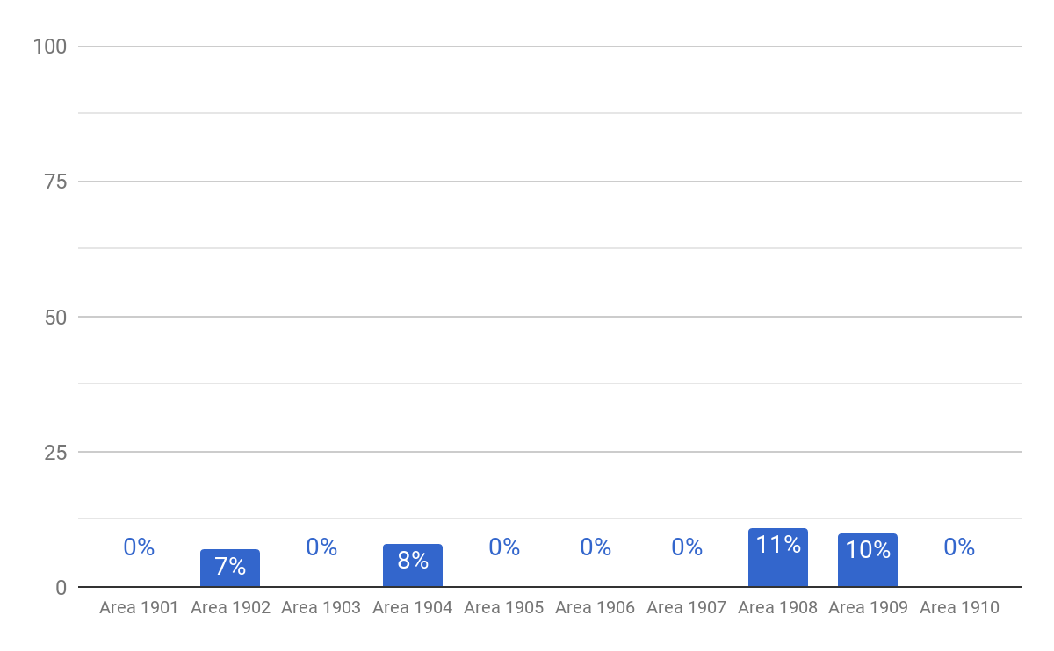
FAST & FRIENDLY UPSELL - REGION 1900

Slide 36
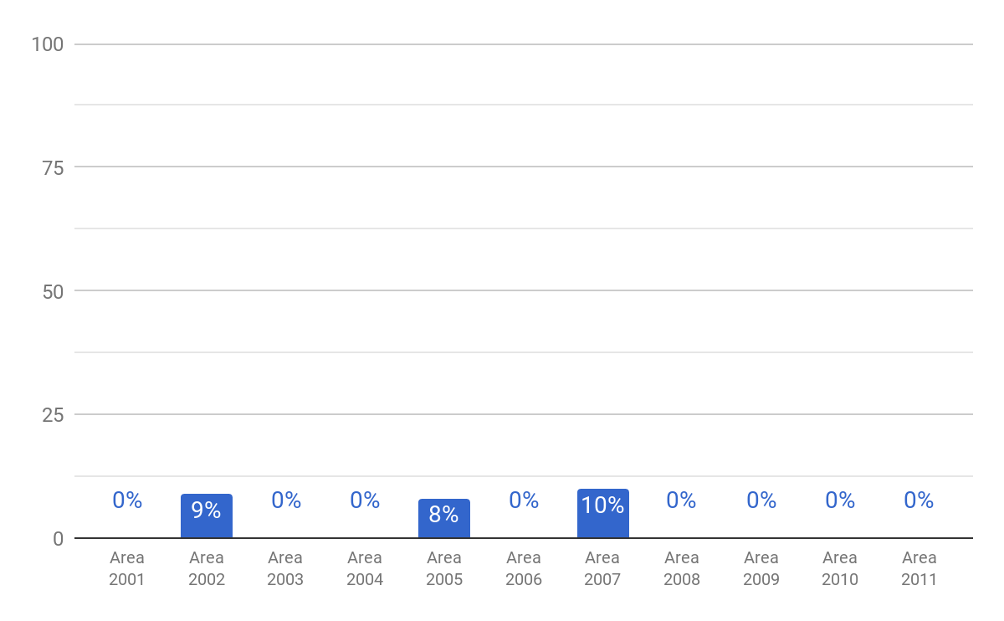
FAST & FRIENDLY UPSELL - REGION 2000

Slide 37
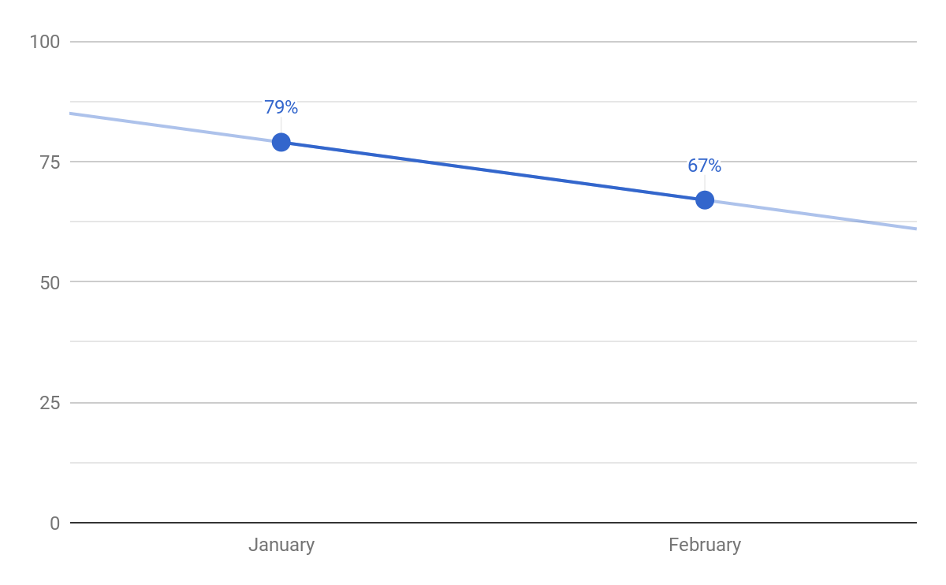
FAST & FRIENDLY BEVERAGES

Slide 38
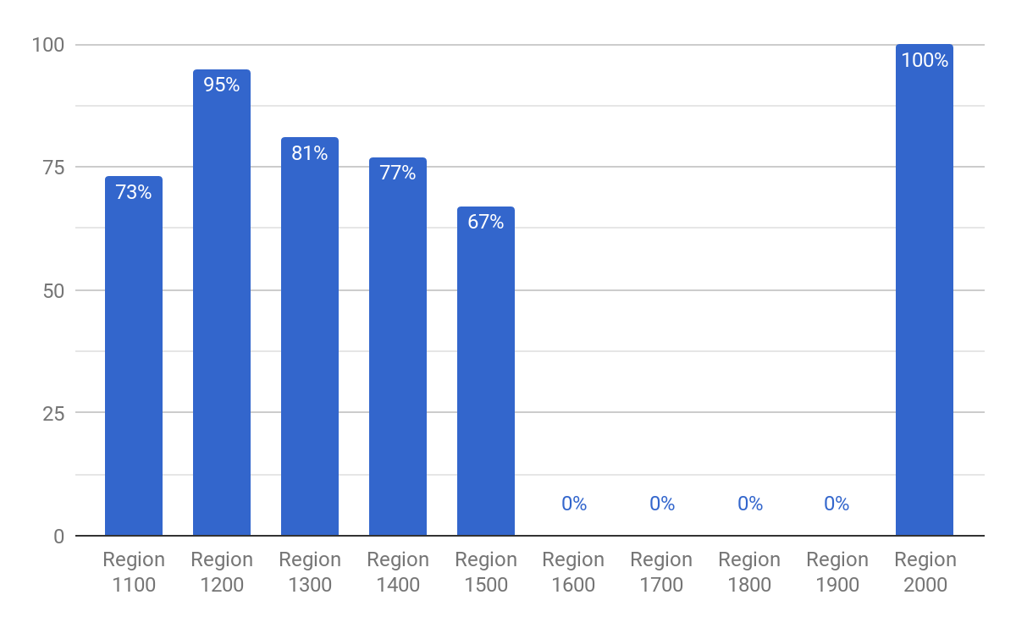
FAST & FRIENDLY BEVERAGES - REGIONS

Slide 39
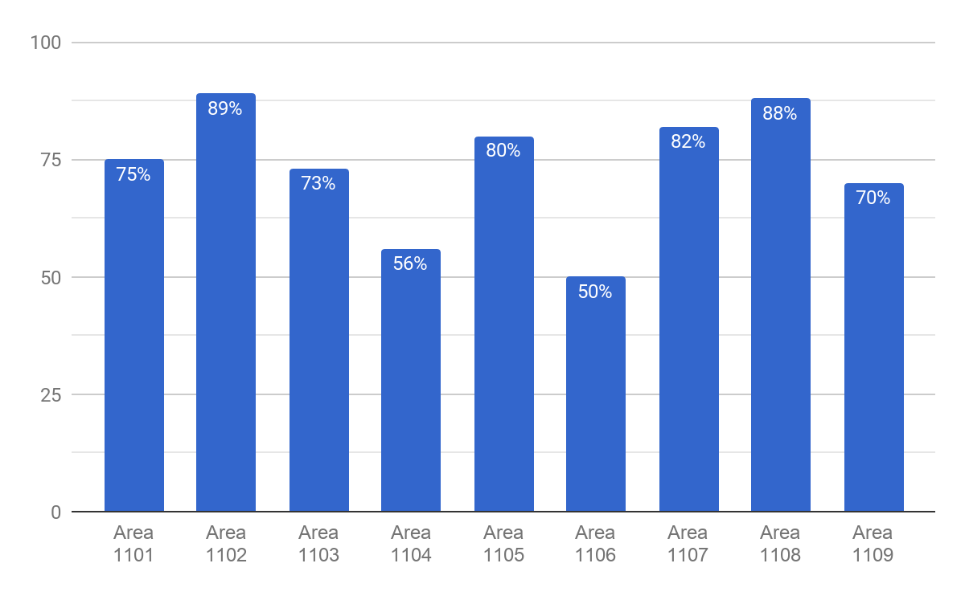
FAST & FRIENDLY BEVERAGES - REGION 1100

Slide 40
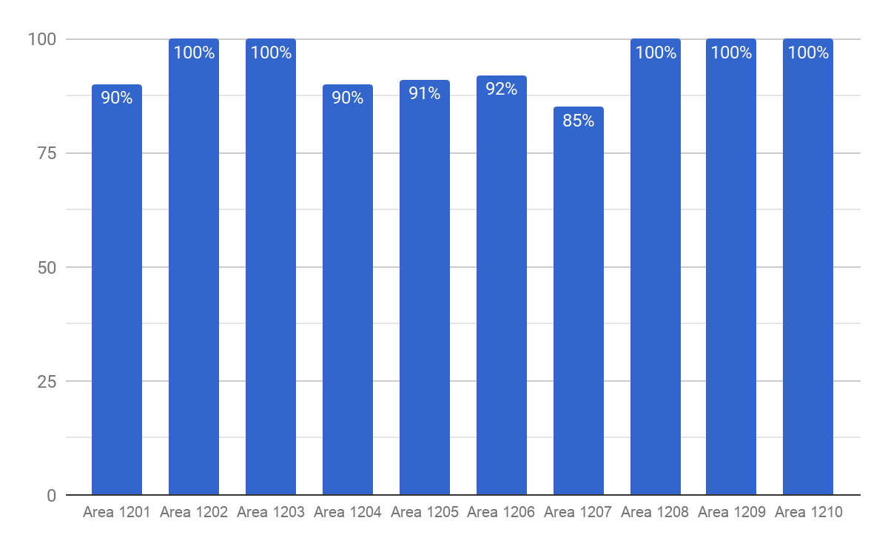
FAST & FRIENDLY BEVERAGES - REGION 1200

Slide 41
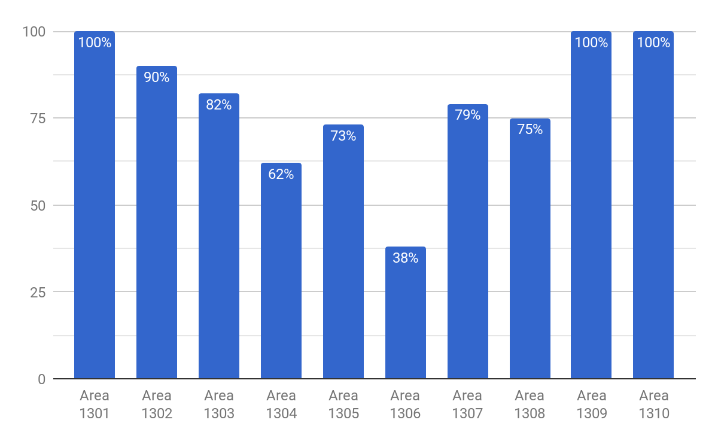
FAST & FRIENDLY BEVERAGES - REGION 1300

Slide 42
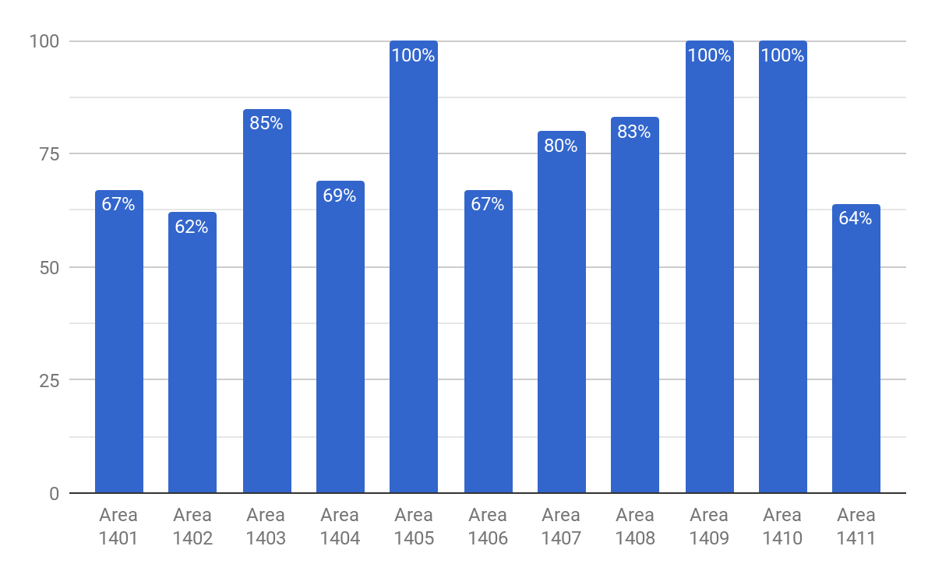
FAST & FRIENDLY BEVERAGES - REGION 1400

Slide 43
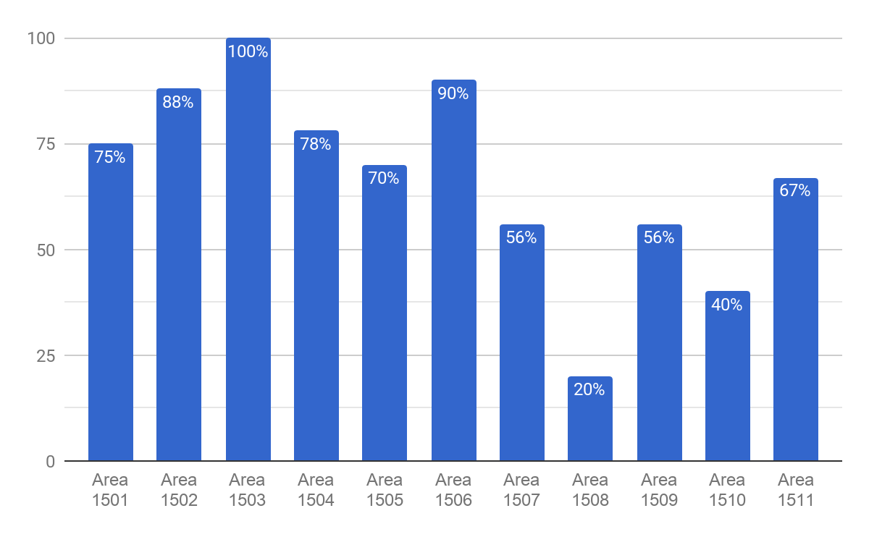
FAST & FRIENDLY BEVERAGES - REGION 1500

Slide 44
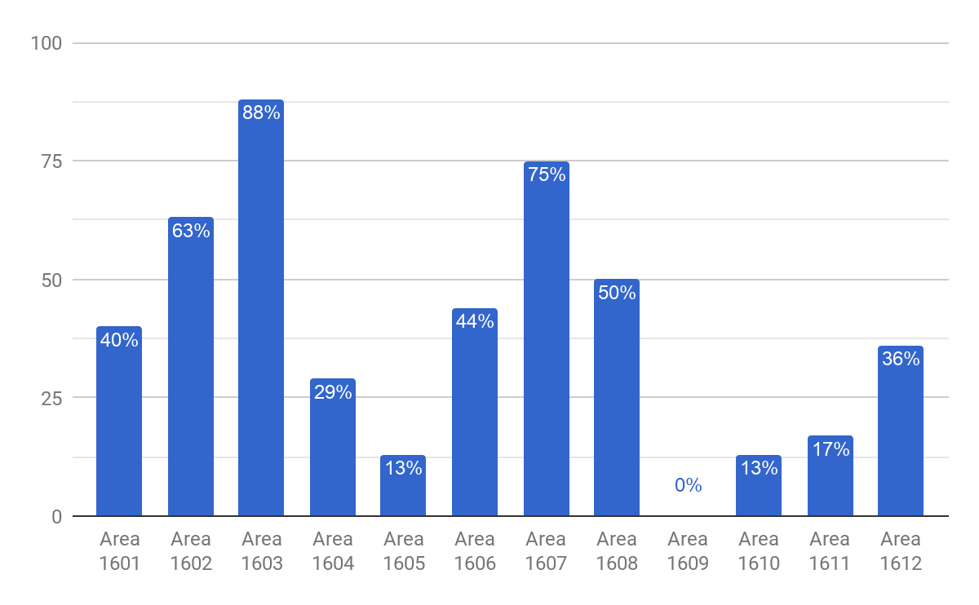
FAST & FRIENDLY BEVERAGES - REGION 1600

Slide 45
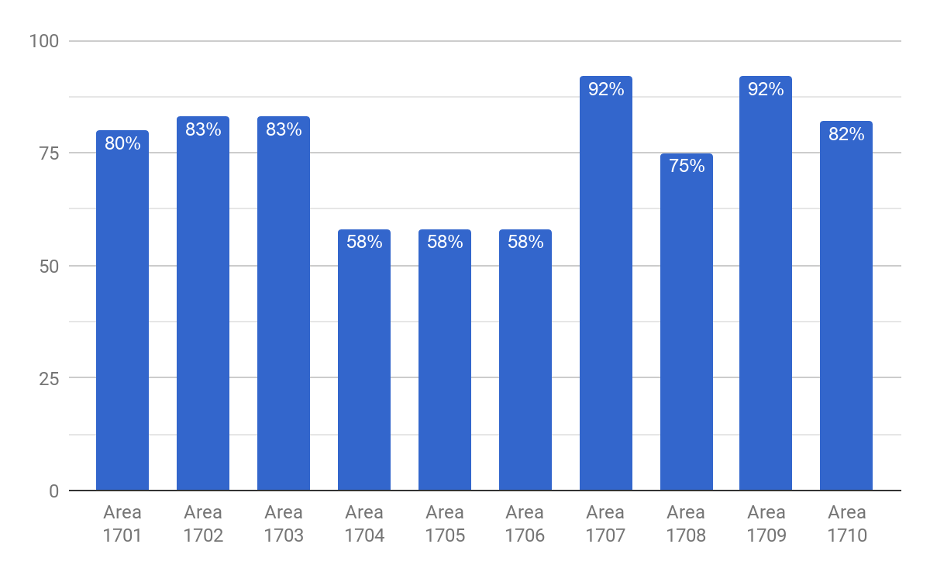
FAST & FRIENDLY BEVERAGES - REGION 1700

Slide 46
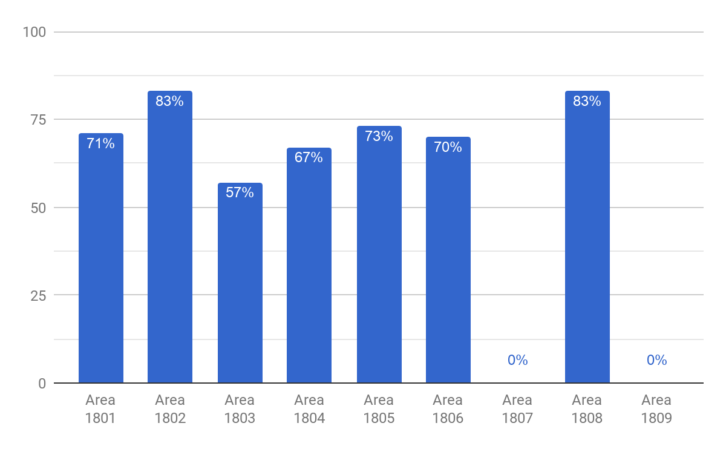
FAST & FRIENDLY BEVERAGES - REGION 1800

Slide 47
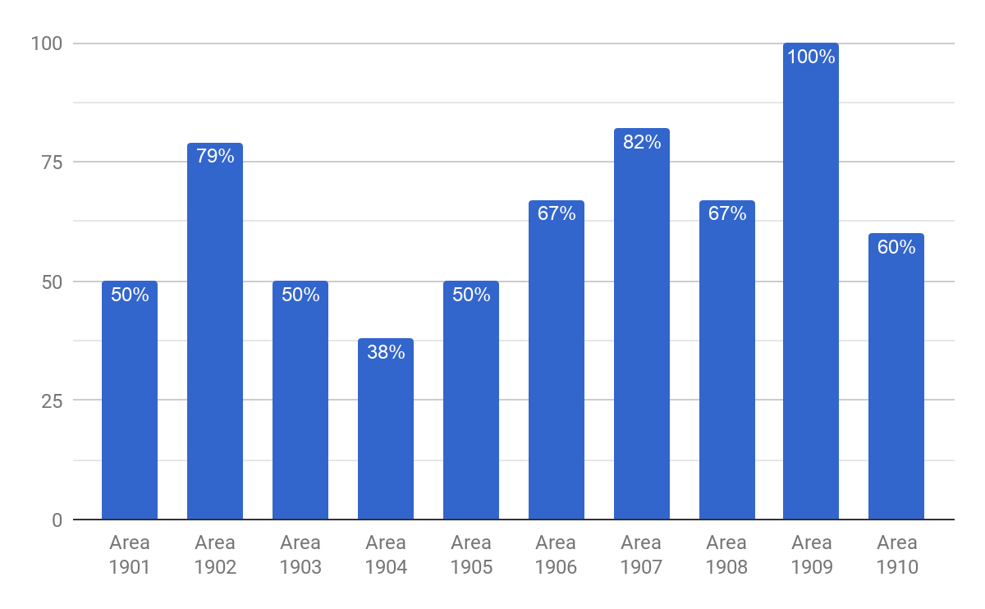
FAST & FRIENDLY BEVERAGES - REGION 1900

Slide 48
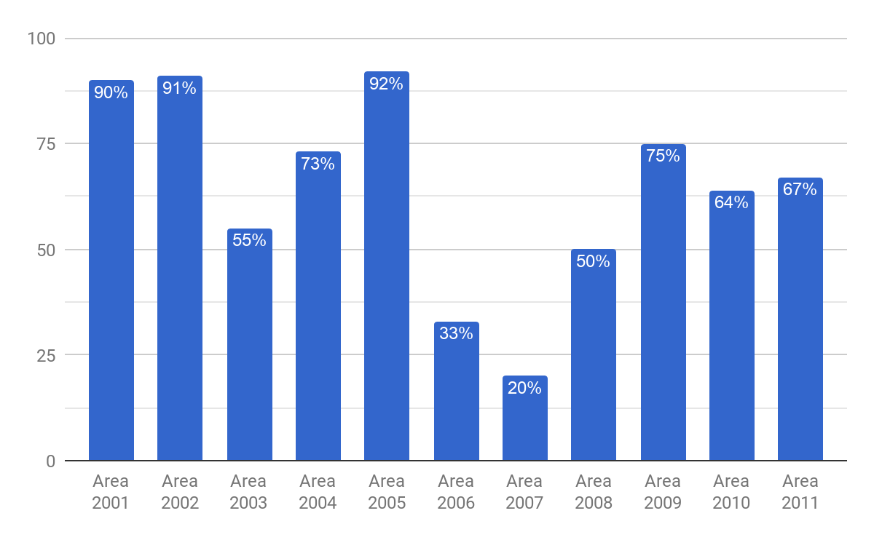
FAST & FRIENDLY BEVERAGES - REGION 2000

Slide 49
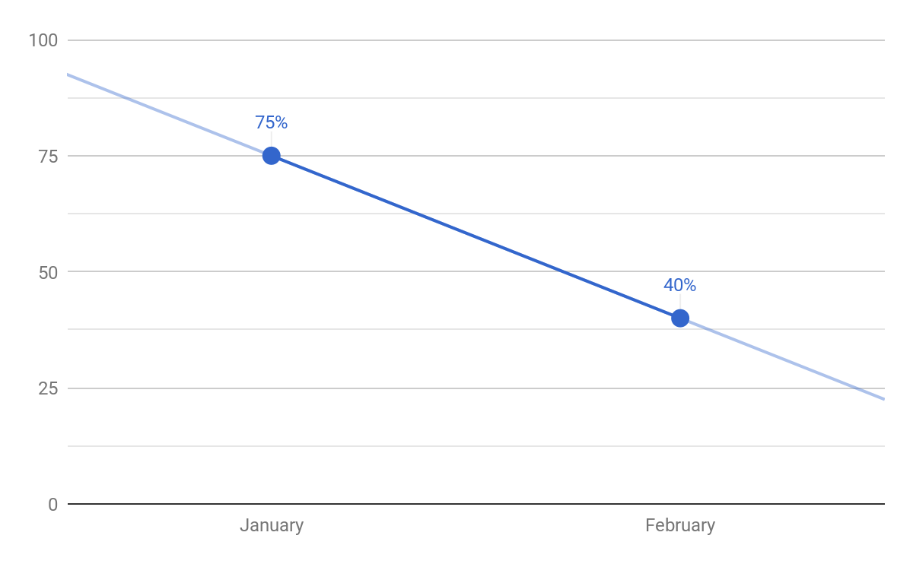
FAST & FRIENDLY HOT ITEMS

Slide 50
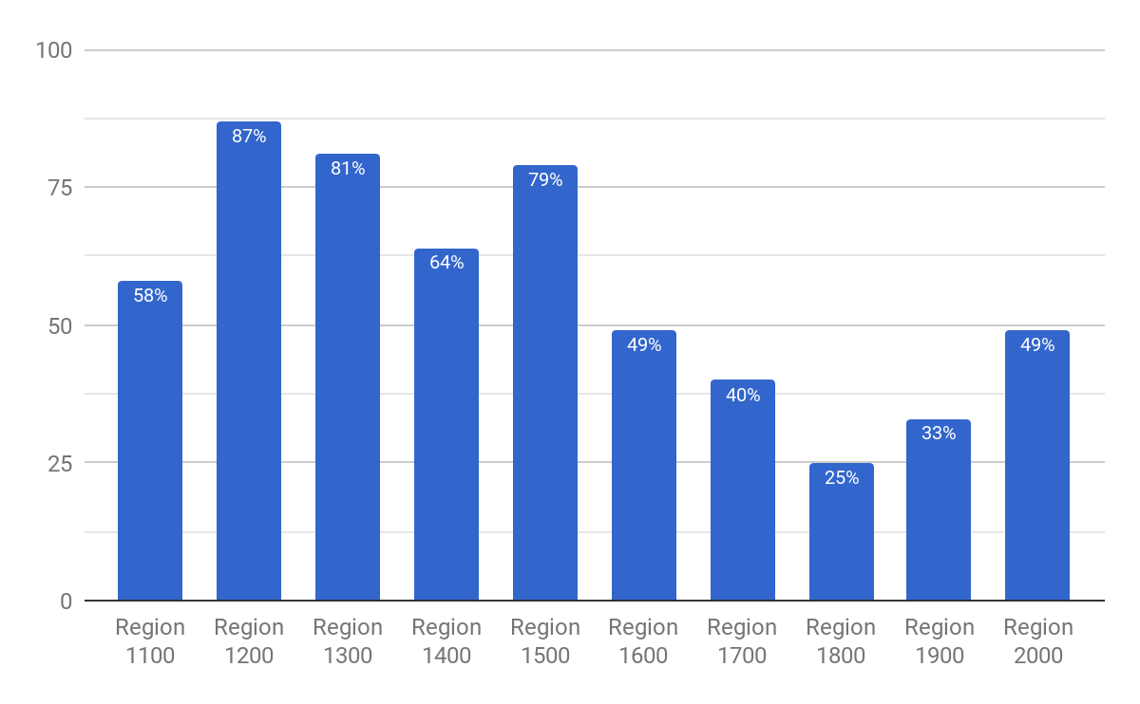
FAST & FRIENDLY HOT ITEMS - REGIONS

Slide 51
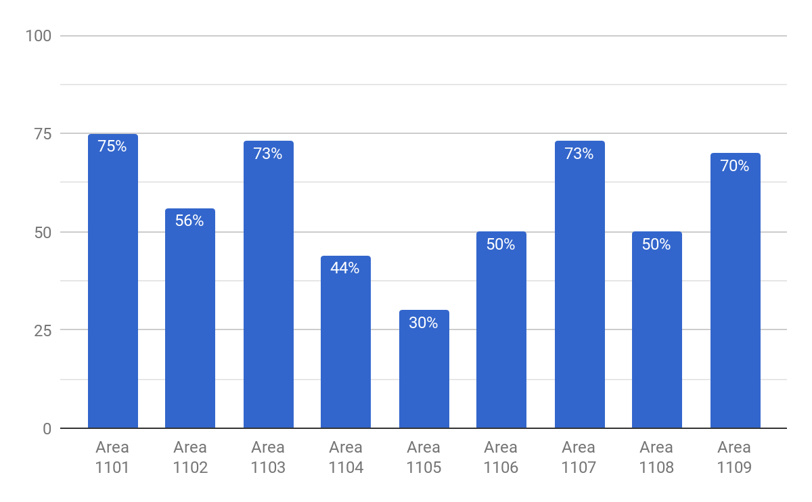
FAST & FRIENDLY HOT ITEMS - REGION 1100

Slide 52
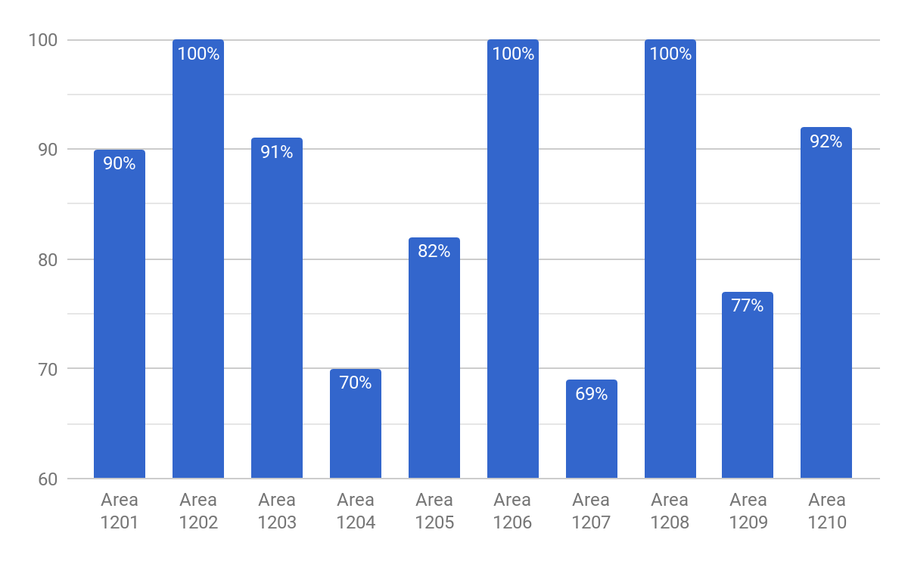
FAST & FRIENDLY HOT ITEMS - REGION 1200

Slide 53
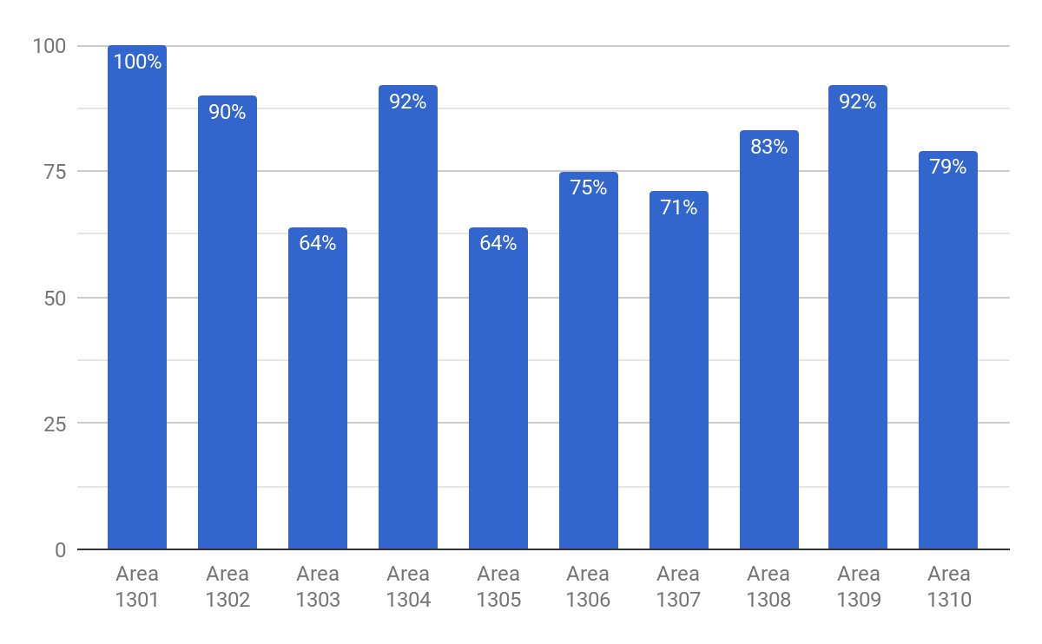
FAST & FRIENDLY HOT ITEMS - REGION 1300

Slide 54
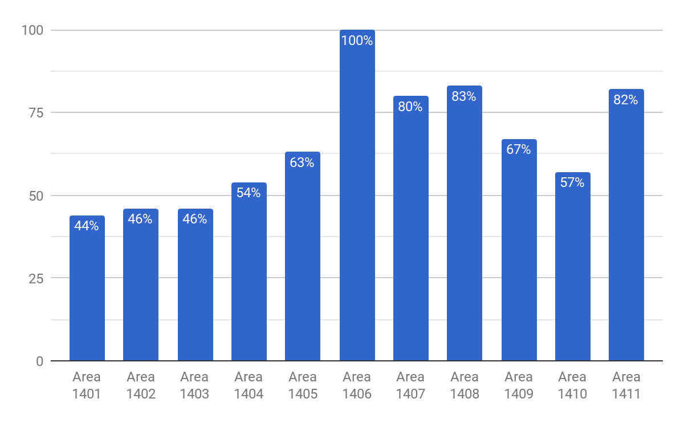
FAST & FRIENDLY HOT ITEMS - REGION 1400

Slide 55
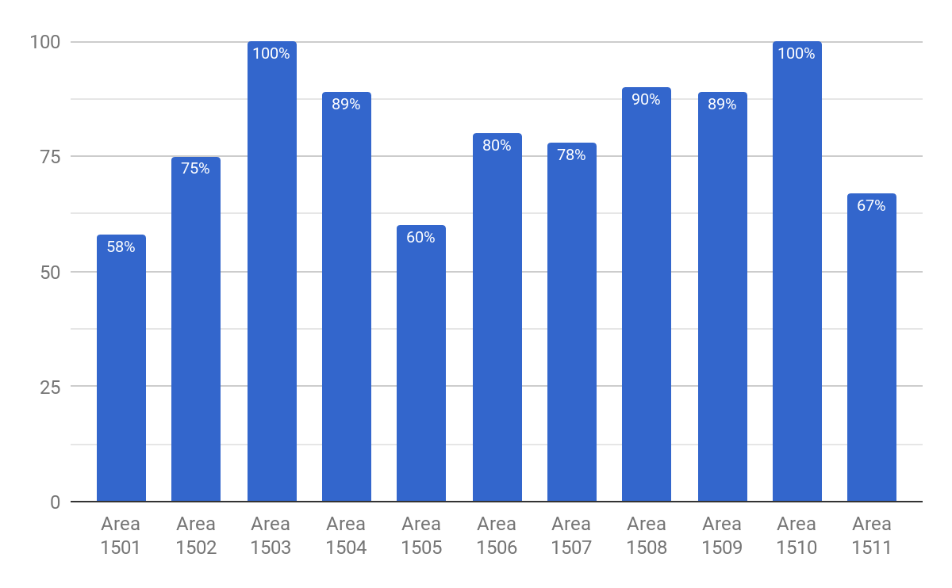
FAST & FRIENDLY HOT ITEMS - REGION 1500

Slide 56
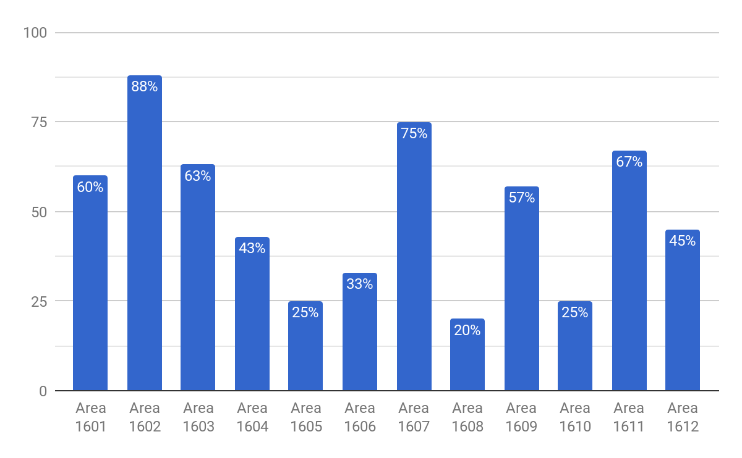
FAST & FRIENDLY HOT ITEMS - REGION 1600

Slide 57
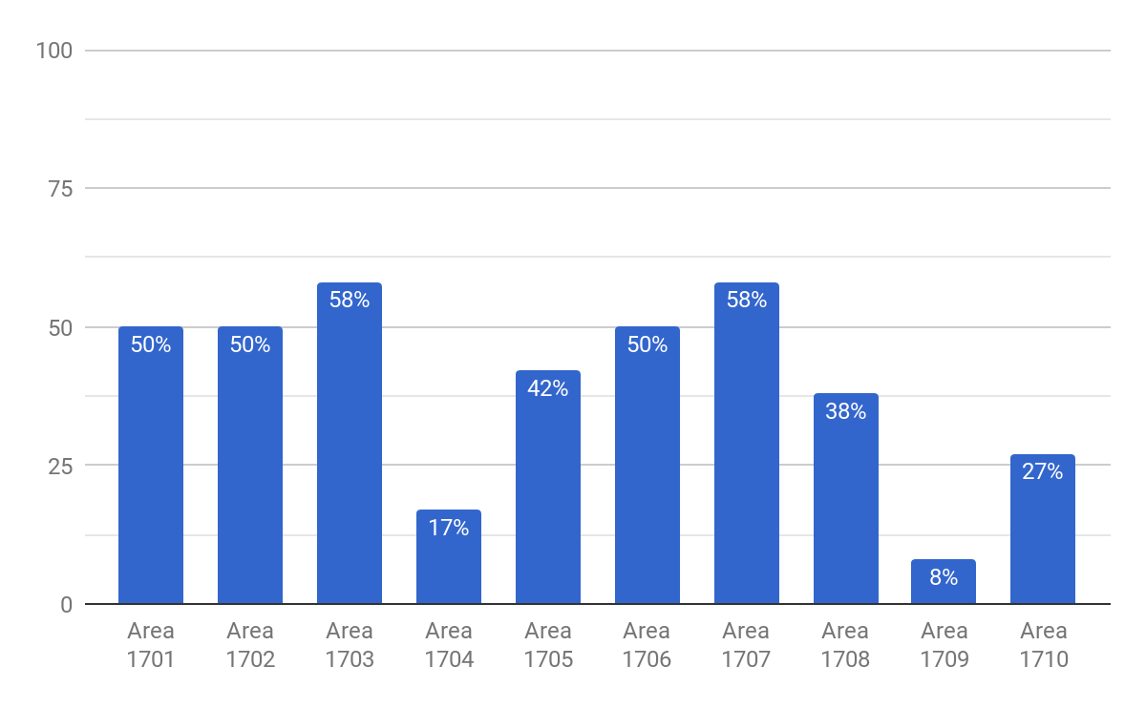
FAST & FRIENDLY HOT ITEMS - REGION 1700

Slide 58
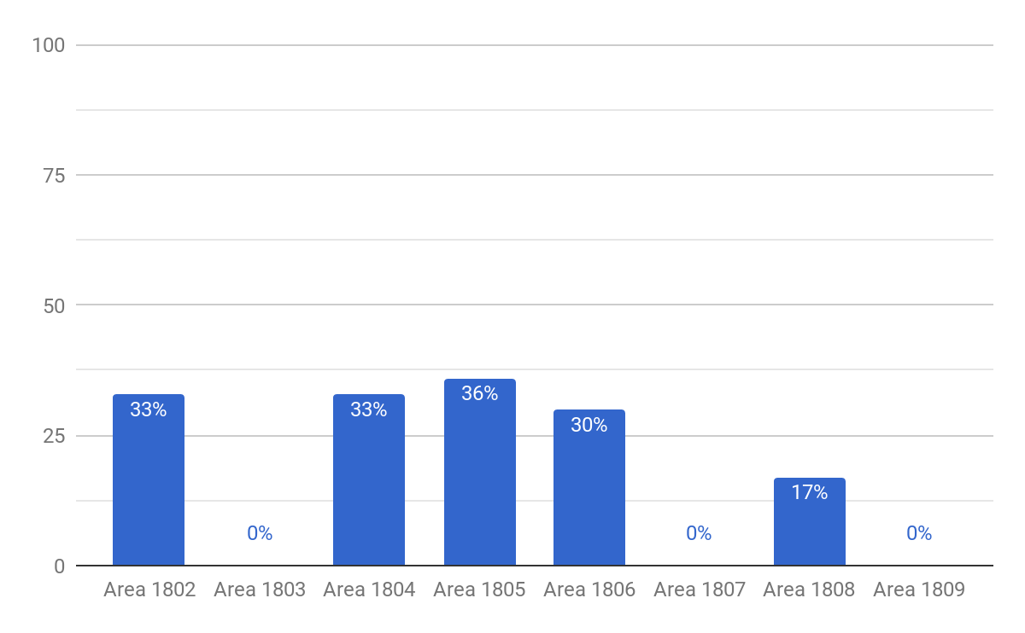
FAST & FRIENDLY HOT ITEMS - REGION 1800

Slide 59
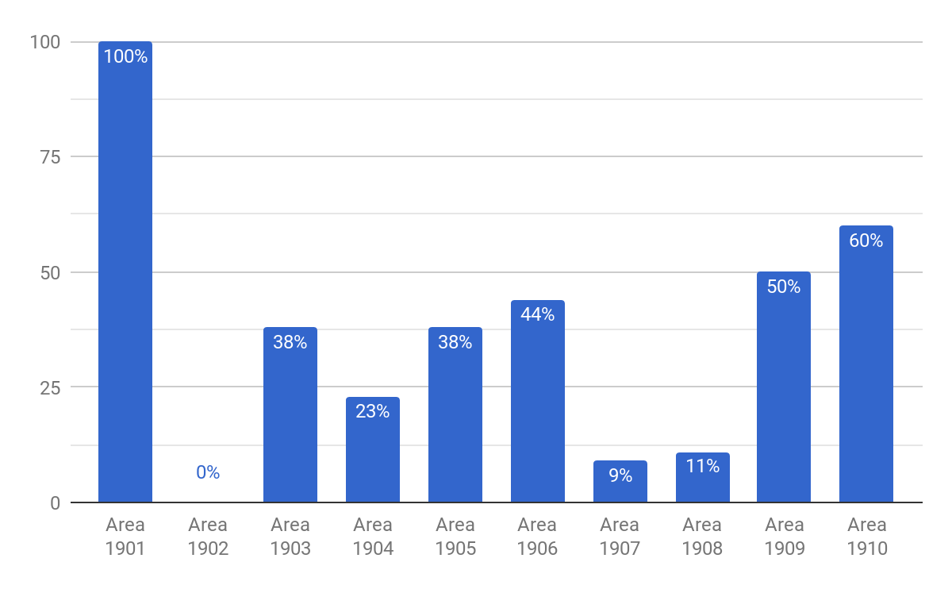
FAST & FRIENDLY HOT ITEMS - REGION 1900

Slide 60
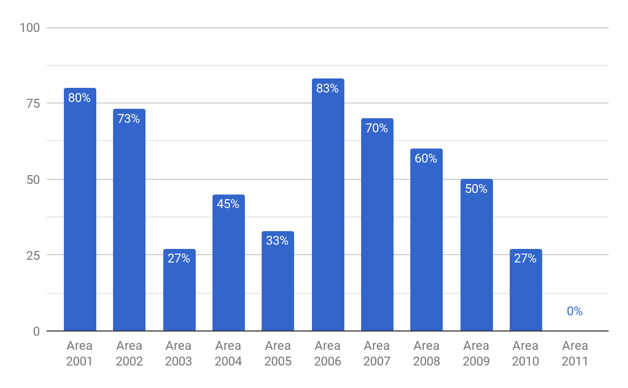
FAST & FRIENDLY HOT ITEMS - REGION 2000

Slide 61
TOP PERFORMING AREA MANAGERS
Rank | Area | Evaluations | Average
 |  |  | Score %
1 | Area 1202 - Elsa Gupta | 10 | 94.60
2 | Area 1205 - Emma Flores | 11 | 91.82
3 | Area 1310 - Ismael Flores | 14 | 91.79
4 | Area 1204 - Mario Rodriguez | 10 | 91.70
5 | Area 1301 - Joe Rios | 11 | 90.36
6 | Area 1406 - Tammy Parker | 1 | 90.00
7 | Area 1501 - Laura Meekins | 12 | 89.17
8 | Area 1309 - Jesse Chavez | 12 | 88.25
9 | Area 1203 - Carmen Ortega | 11 | 88.00
10 | Area 1502 - Gilbert Morales | 8 | 87.75

Slide 62
TOP PERFORMING AREA MANAGERS
Rank | Area | Evaluations | Average
 |  |  | Score %
98 | Area 1403 - Hector DeLeon | 9 | 75.67
99 | Area 2011 - Nadeem Shakoor | 9 | 75.56
100 | Area 1704 - Shelley Ross | 11 | 75.36
101 | Area 2004 - Jennifer E. Frank | 11 | 75.18
102 | Area 1904 - Thomas A. Brown | 13 | 75.08
103 | Area 1710 - Leon Bailey | 11 | 73.45
104 | Area 1610 - Greg Scott | 8 | 73.38
105 | Area 1108 - Jorge Gonzalez (Temporary) | 8 | 73.25
106 | Area 1903 - Janet M. Carlini | 8 | 73.13
107 | Area 1106 - Janie Hinojosa (Temporary) | 2 | 66.50

